Slide 1
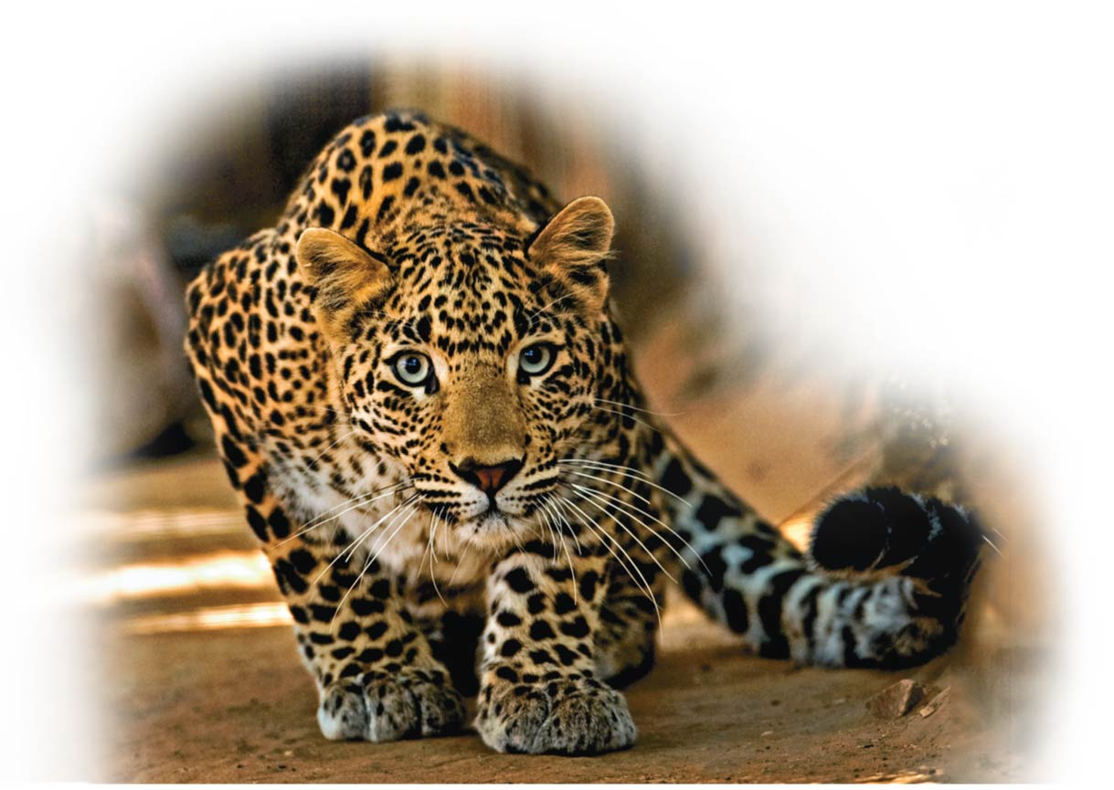
Cellular Reproduction: Cells from Cells
Unit 2; Chapter 8

Slide 2
What Cell Reproduction Accomplishes
Reproduction
may result in the birth of new organisms but
more commonly involves the production of new cells.
When a cell undergoes reproduction, or cell division, two “daughter” cells are produced that are genetically identical to
each other and
the “parent” cell.
Notes:
2

Slide 3
What Cell Reproduction Accomplishes
Before a parent cell splits into two, it duplicates its chromosomes, the structures that contain most of the cell’s DNA.
During cell division, each daughter cell receives one identical set of chromosomes from the lone, original parent cell.
Notes:
3

Slide 4
What Cell Reproduction Accomplishes
Cell division plays several important roles in the lives of organisms. Cell division
replaces damaged or lost cells,
permits growth, and
allows for reproduction.
Notes:
4

Slide 5
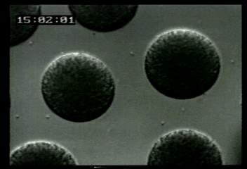
Video: Sea Urchin（海胆） (time lapse)

Slide 6
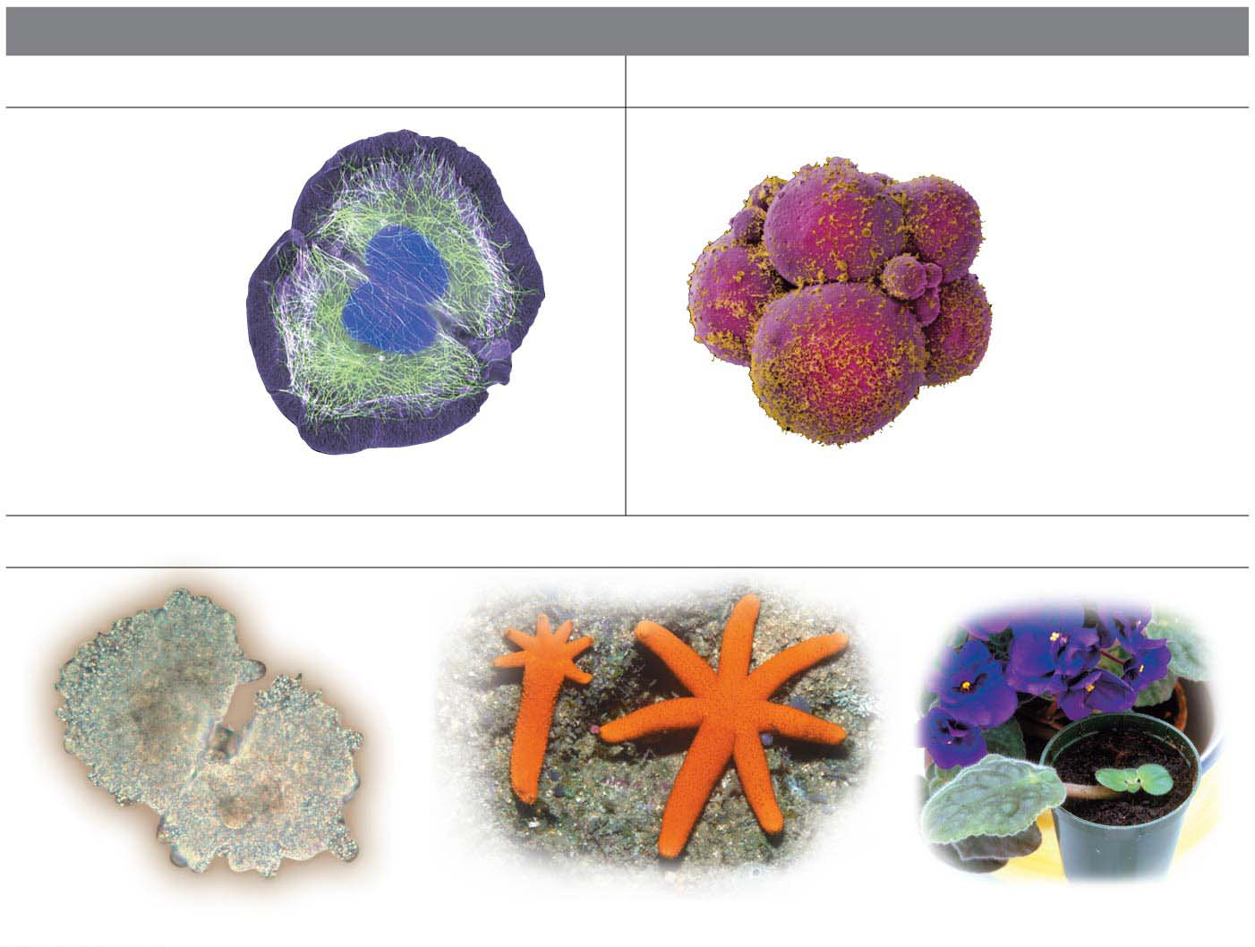
FUNCTIONS OF CELL DIVISION BY MITOSIS
Cell Replacement
Growth via Cell Division
Colorized SEM
LM
Human kidney cell
Early human embryo
Asexual Reproduction
LM
Reproduction of an amoeba
Regeneration of a sea star
Growth of a clipping
Notes:
Figure 8.1 Three functions of cell division by mitosis

Slide 7
What Cell Reproduction Accomplishes?
In asexual reproduction（无性繁殖）,
single-celled organisms reproduce by dividing in half and
there is no fertilization（受精） of an egg by a sperm.
Many multicellular organisms can reproduce asexually as well. For example, some sea star species have the ability to grow new individuals from fragmented pieces.
Growing a new plant from a clipping is another example of asexual reproduction.
Notes:
7

Slide 8
What Cell Reproduction Accomplishes?
In asexual reproduction, the lone parent and its offspring have identical genes.
Mitosis（有丝分裂） is the type of cell division responsible for
asexual reproduction and
growth and maintenance of multicellular organisms.
mito= a thread (mitosis: the division of a diploid cell into two diploid cells)
Notes:
8

Slide 9
What Cell Reproduction Accomplishes?
Sexual reproduction（有性生殖）requires fertilization of an egg by a sperm.
The production of gametes（配子）— egg and sperm — involves a special type of cell division called meiosis（减数分裂）, which occurs only in reproductive organs.
gamet = a wife or husband (gamete: egg or sperm)
Mei = less (meiosis: the division of a diploid nucleus into four haploid daughter nuclei)
Notes:
9

Slide 10
What Cell Reproduction Accomplishes?
In summary, two kinds of cell division are involved in the lives of sexually reproducing organisms:
mitosis for growth and maintenance and
meiosis for reproduction.
Notes:
10

Slide 11
The Cell Cycle and Mitosis
In a eukaryotic cell,
most genes are located on chromosomes in the cell nucleus and
a few genes are found in DNA in mitochondria and chloroplasts.
Notes:
11

Slide 12
Eukaryotic Chromosomes
Each eukaryotic chromosome contains one very long DNA molecule, typically bearing thousands of genes.
The number of chromosomes in a eukaryotic cell depends on the species.
Notes:
12

Slide 13
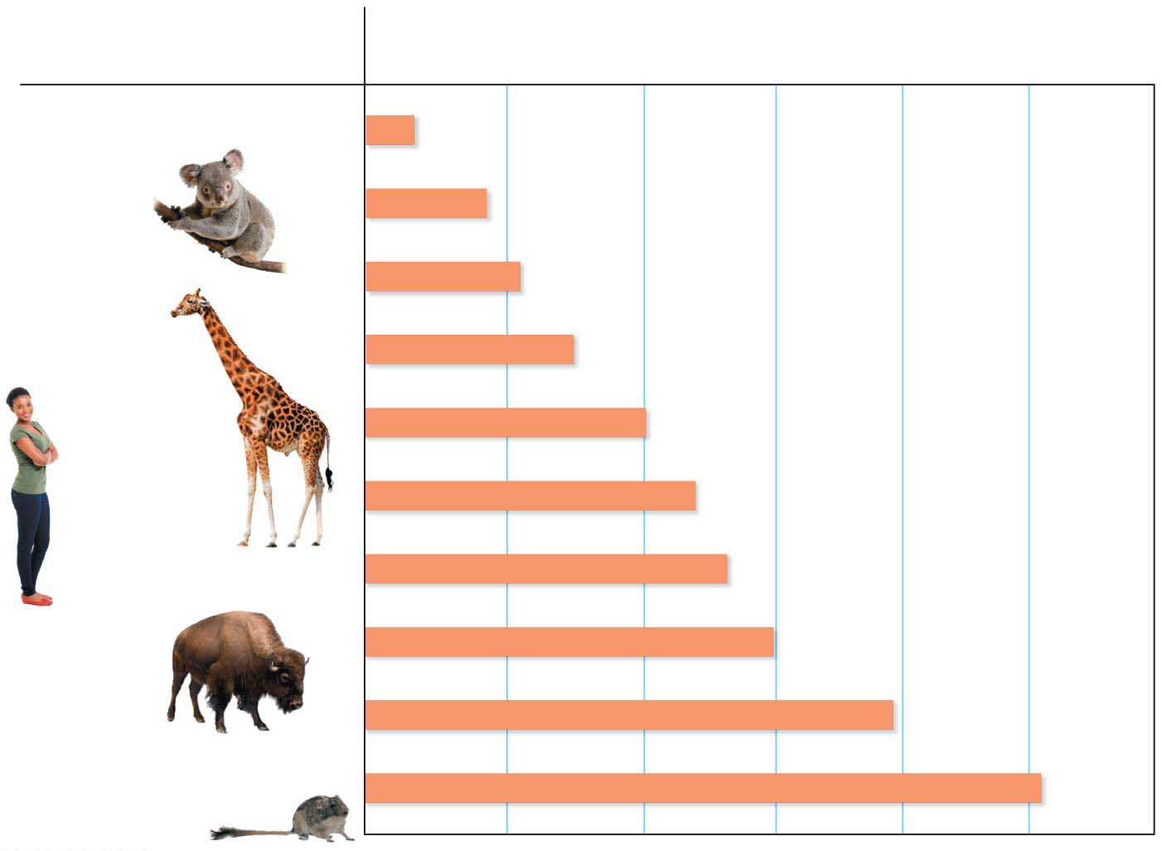
Species
Number of chromosomes in body cells
Indian muntjac deer
6
Koala
16
Opossum
22
Giraffe
30
Mouse
40
46
Human
Duck-billed platypus
54
Bison
60
Dog
78
Red viscacha rat
102
Notes:
Figure 8.2 The number of chromosomes in the cells of selected mammals

Slide 14
Eukaryotic Chromosomes
Chromosomes are made of chromatin, fibers composed of roughly equal amounts of DNA and protein molecules, which help
organize the chromatin and
control the activity of its genes.
Notes:
14

Slide 15
Eukaryotic Chromosomes
Most of the time, the chromosomes exist as thin fibers that are much longer than the nucleus they are stored in.
If fully extended, the DNA in just one of your cells would be more than six feet long!
As a cell prepares to divide, its chromatin fibers coil up, forming compact chromosomes that can be viewed under a light microscope.
When a cell is not dividing, the chromosomes are too thin to be seen under a light microscope.
Notes:
15

Slide 16
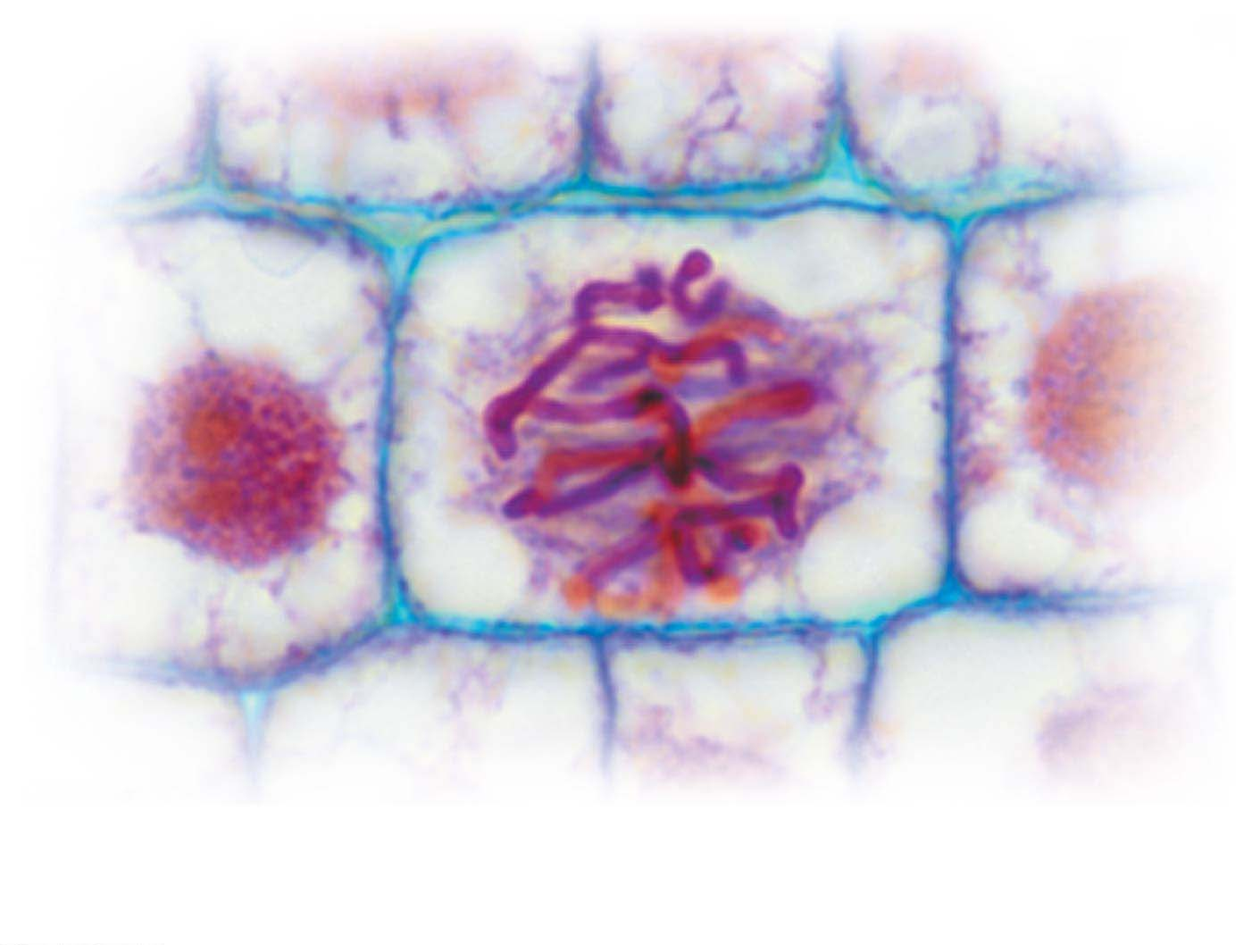
LM
Chromosomes

Slide 17
Eukaryotic Chromosomes
The DNA in a cell is packed into an elaborate, multilevel system of coiling and folding.
Histones（组蛋白） are proteins used to package DNA in eukaryotes.
Nucleosomes（核小体） consist of DNA wound around histone molecules.
Notes:
17

Slide 18
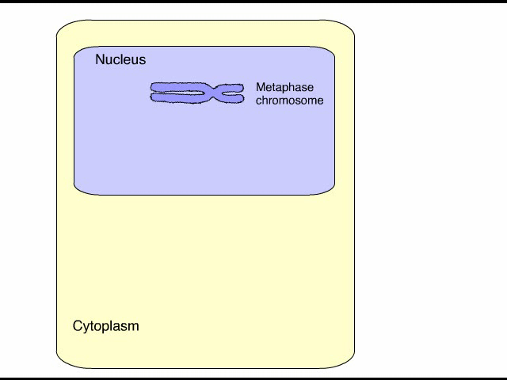
Animation: DNA Packing

Slide 19
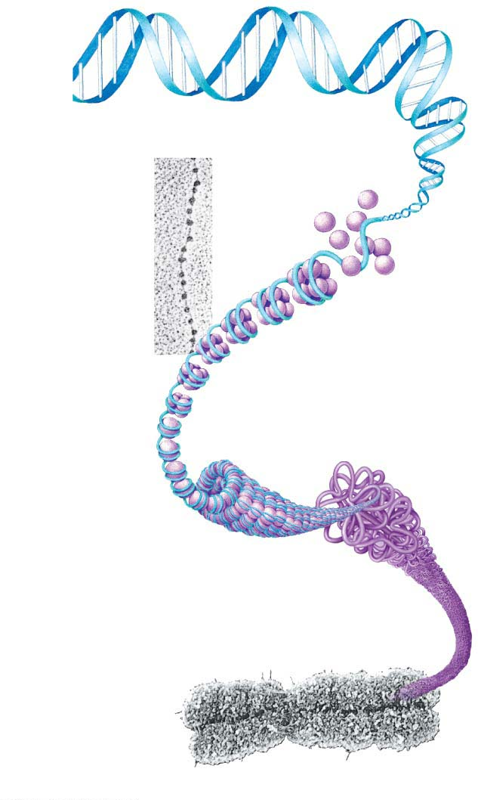
Figure 8.4
DNA double helix
Histones
“Beads
on a
string”
TEM
Nucleosome
Duplicated
chromosomes
(sister
chromatids)
TEM
Centromere
Notes:
Figure 8.4 DNA packing in a eukaryotic chromosome

Slide 20
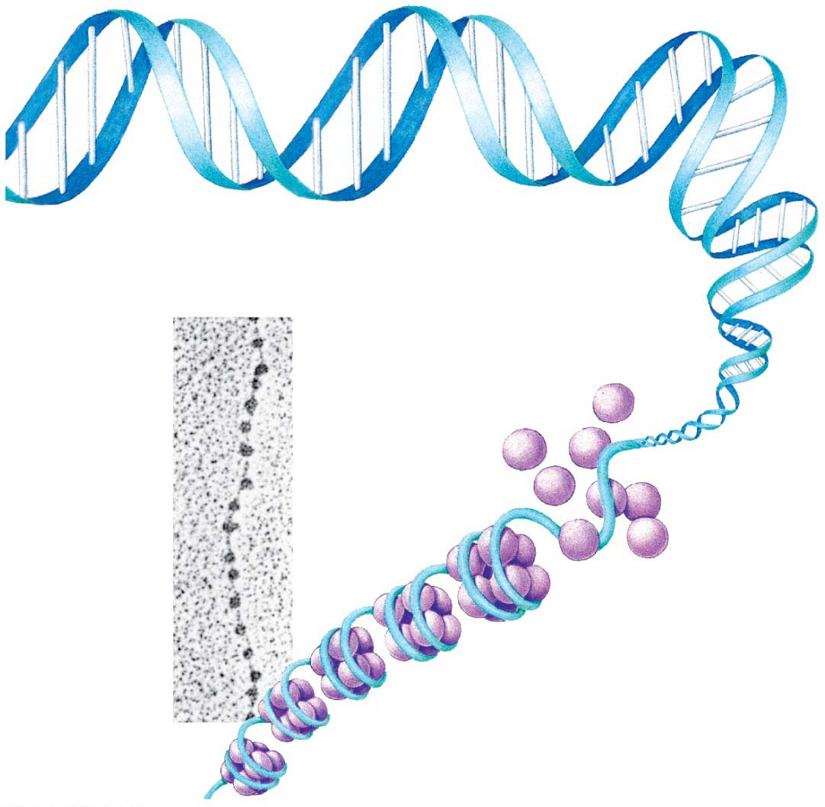
Figure 8.4-1
DNA double helix
Histones
“Beads on
a string”
TEM
Nucleosome
Notes:
Figure 8.4-1 DNA packing in a eukaryotic chromosome (part 1: helix to nucleosome)

Slide 21
Information Flow: Duplicating Chromosomes
Before a cell begins the division process,
the DNA molecule of each chromosome is copied through the process of DNA replication and
new histone protein molecules attach as needed.
The result is that each chromosome consists of two copies called sister chromatids（姐妹染色单体）, which contain identical genes.
Two sister chromatids are joined together tightly at a narrow “waist” called the centromere（着丝点）.
Notes:
21

Slide 22
Information Flow: Duplicating Chromosomes
When the cell divides, the sister chromatids of a duplicated chromosome separate from each other.
Once separated from its sister, each chromatid
is considered a full-fledged chromosome and
is identical to the original chromosome.
Notes:
22

Slide 23
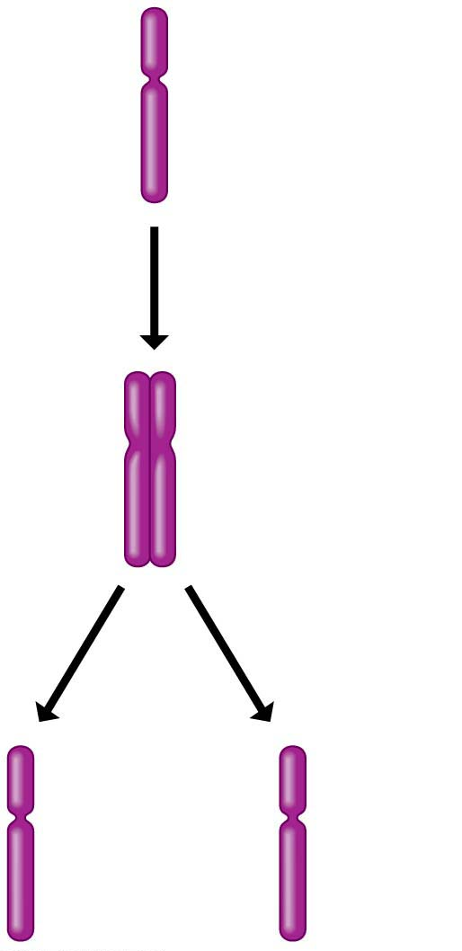
Figure 8.5
Chromosome
duplication
Sister
chromatids
Chromosome
distribution to
daughter cells
Notes:
Figure 8.5 Duplication and distribution of a single chromosome

Slide 24
The Cell Cycle（细胞周期）
A cell cycle is the ordered sequence of events that extend from the time a cell is first formed from a dividing parent cell to its own division into two cells.
Think of the cell cycle as the “lifetime” of a cell, from its “birth” to its own reproduction.
Notes:
24

Slide 25
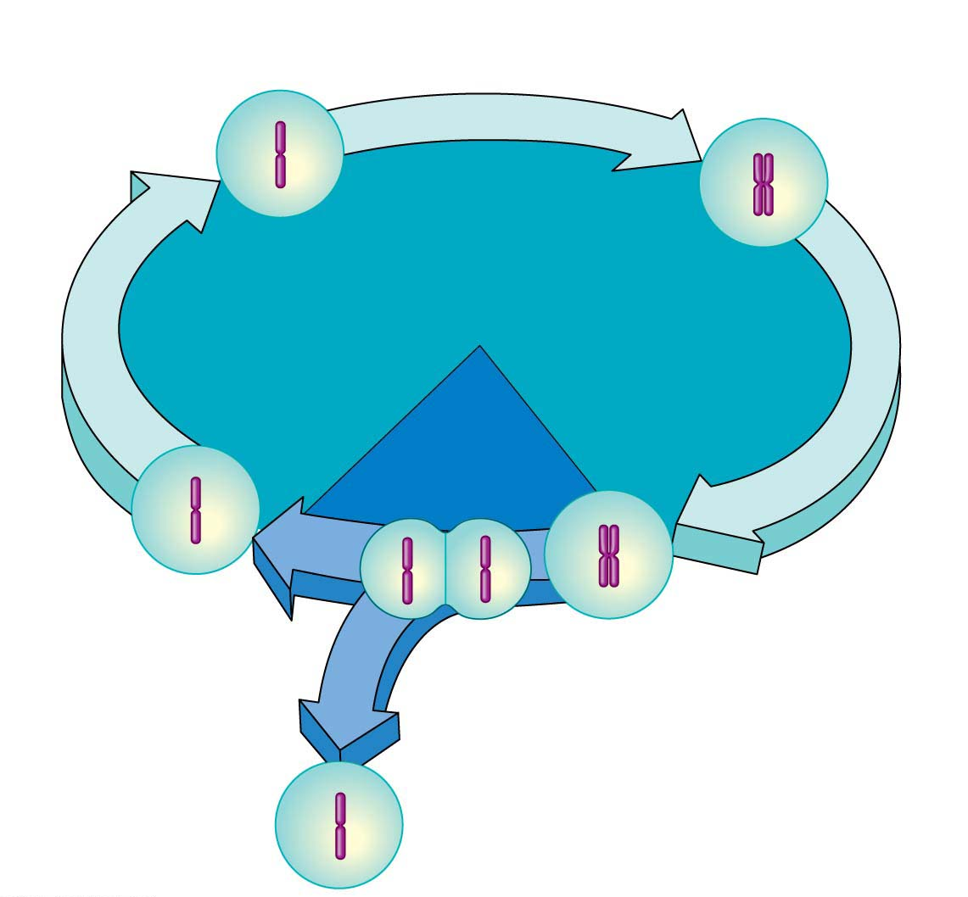
S phase
(DNA synthesis; chromosome duplication)
Interphase: metabolism and
growth (90% of time)
G₁
G₂
Mitotic
(M) phase:
cell division
(10% of time)
Cytokinesis
（胞质分裂）
(division of cytoplasm)
Mitosis
(division of nucleus)
Cyto=cell; kinet= move
(cytokinesis: division of the cytoplasm)
Notes:
Figure 8.6 The eukaryotic cell cycle

Slide 26
The Cell Cycle
Most of the cell cycle is spent in interphase, which lasts for at least 90% of the cell cycle.
During interphase, a cell
performs its normal functions,
doubles everything in its cytoplasm, and
grows in size.
Notes:
26

Slide 27
The Cell Cycle
From the standpoint of cell reproduction, the most important event of interphase is chromosome duplication, when the DNA in the nucleus is precisely doubled.
The period when this occurs is called the S phase (for DNA synthesis).
Notes:
27

Slide 28
The Cell Cycle
The interphase periods before and after the S phase are called the G₁ and G₂ phases, respectively (G stands for gap).
During G₁, each chromosome is single, and the cell performs its normal functions.
During G₂ (after DNA duplication during the S phase), each chromosome in the cell consists of two identical sister chromatids, and the cell prepares to divide.
Notes:
28

Slide 29
The Cell Cycle
The mitotic (M) phase includes two overlapping processes:
mitosis, in which the nucleus and its contents divide evenly into two daughter nuclei, and
cytokinesis, in which the cytoplasm (along with all the organelles) is divided in two.
The combination of mitosis and cytokinesis produces two genetically identical daughter cells.
Cyto=cell; kinet= move (cytokinesis: division of the cytoplasm)
Notes:
29

Slide 30
Mitosis and Cytokinesis
Mitosis consists of four distinct phases:
Prophase（前期）
Metaphase（中期）
Anaphase（后期）
Telophase（末期）
pro= before (prophase: mitotic stage when the nuclear membrane first breaks up)
Meta= between (metaphase: mitotic stage when the chromosomes are lined up in the cell’s middle)
Ana= again (anaphase: mitotic stage when sister chromatids separate)
Telo= end (telophase: final mitotic stage when the nuclear envelop reforms)
Notes:
30

Slide 31
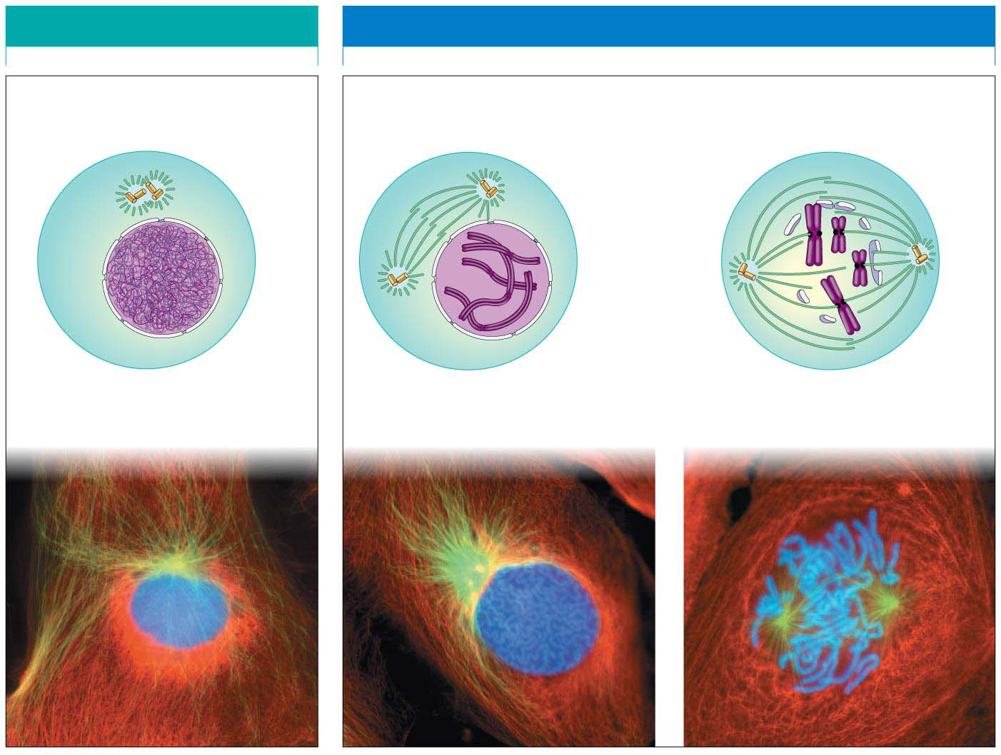
INTERPHASE
PROPHASE
Centro-
somes
Uncondensed
chromosome
Mitotic spindle
forming
Fragments
of nuclear
envelope
Condensed
chromosome
Centromere
Nuclear
envelope
Plasma
membrane
Chromosome
(two sister chromatids)
Spindle（纺锤体） tracks
Notes:
Figure 8.7-1 Cell reproduction: a dance of the chromosomes (part 1: interphase and prophase)

Slide 32
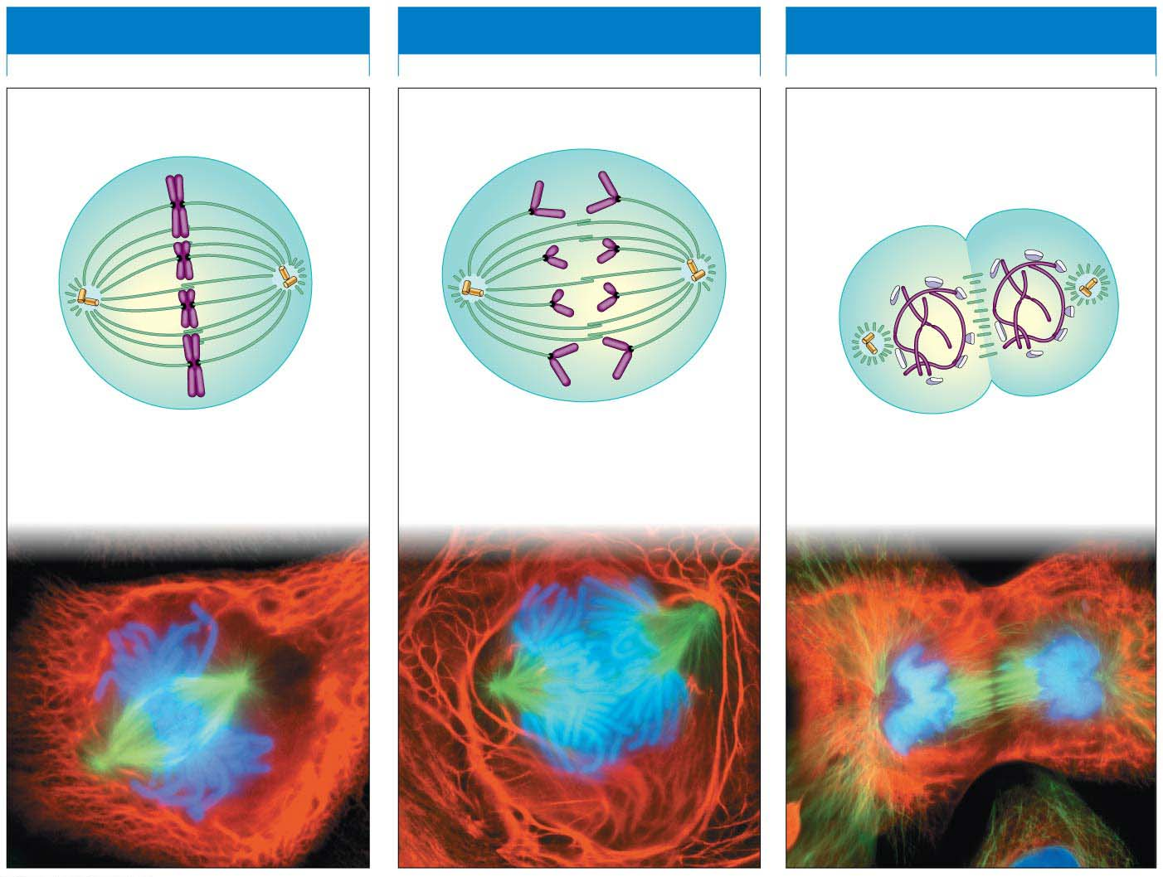
METAPHASE
ANAPHASE
TELOPHASE
Nuclear
envelope
forming
Cleavage
furrow
Condensed
chromosomes align
Separated
chromosomes
It’s a reverse of prophase.
Notes:
Figure 8.7-2 Cell reproduction: a dance of the chromosomes (part 2: metaphase, anaphase, and telophase)

Slide 33
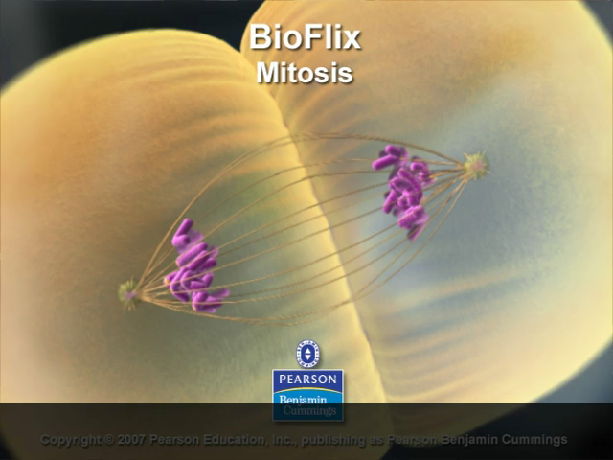
Bioflix Animation: Mitosis

Slide 34
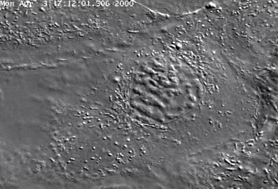
Video: Animal Mitosis

Slide 35
Mitosis and Cytokinesis
The chromosomes and their movements depend on the mitotic spindle, a football-shaped structure of microtubules that guides the separation of the two sets of daughter chromosomes.
Notes:
35

Slide 36
Mitosis and Cytokinesis
Cytokinesis
usually begins during telophase,
divides the cytoplasm, and
is different in plant and animal cells.
Notes:
36

Slide 37
Mitosis and Cytokinesis
In animal cells, cytokinesis
is known as cleavage and
begins with the appearance of a cleavage furrow, an indentation at the equator of the cell.
Notes:
37

Slide 38
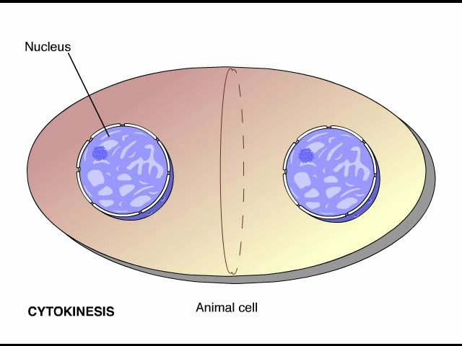
Animation: Cytokinesis

Slide 39
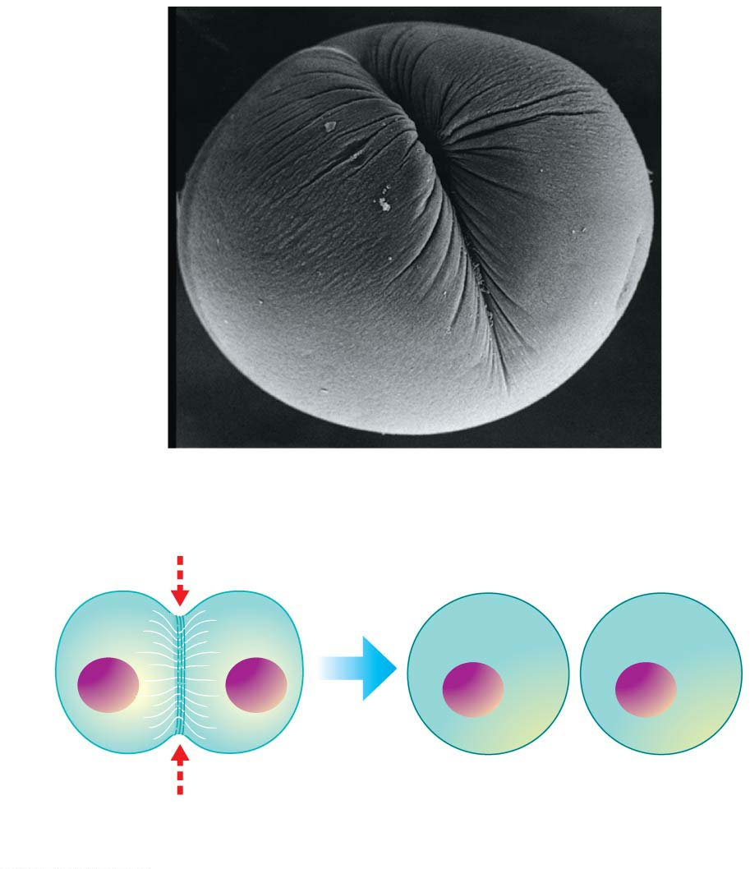
Figure 8.8-1
SEM
Cleavage
furrow
Cleavage furrow
Contracting ring of
microfilaments
Daughter cells
(a) Animal cell cytokinesis
Notes:
Figure 8.8-1 Cytokinesis in animal and plant cells (part 1: animal)

Slide 40
Mitosis and Cytokinesis
In plant cells, cytokinesis begins when vesicles containing cell wall material collect at the middle of the cell and then fuse, forming a membranous disk called the cell plate（细胞板）.
The cell plate grows outward, accumulating more cell wall material as more vesicles join it.
Eventually, the membrane of the cell plate fuses with the plasma membrane, and the cell plate’s contents join the parental cell wall.
Notes:
40

Slide 41
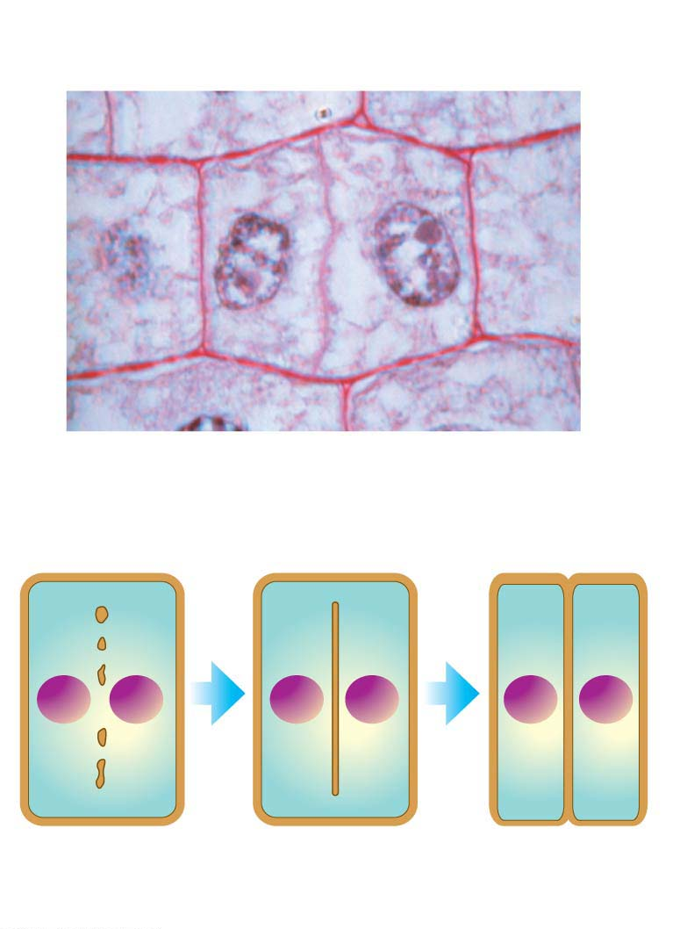
Figure 8.8-2
Wall of
parent cell
Cell plate
forming
Daughter
nucleus
LM
Cell
wall
Vesicles containing
cell wall material
New
cell wall
Cell plate
Daughter cells
(b) Plant cell cytokinesis
Notes:
Figure 8.8-2 Cytokinesis in animal and plant cells (part 2: plant cell)

Slide 42
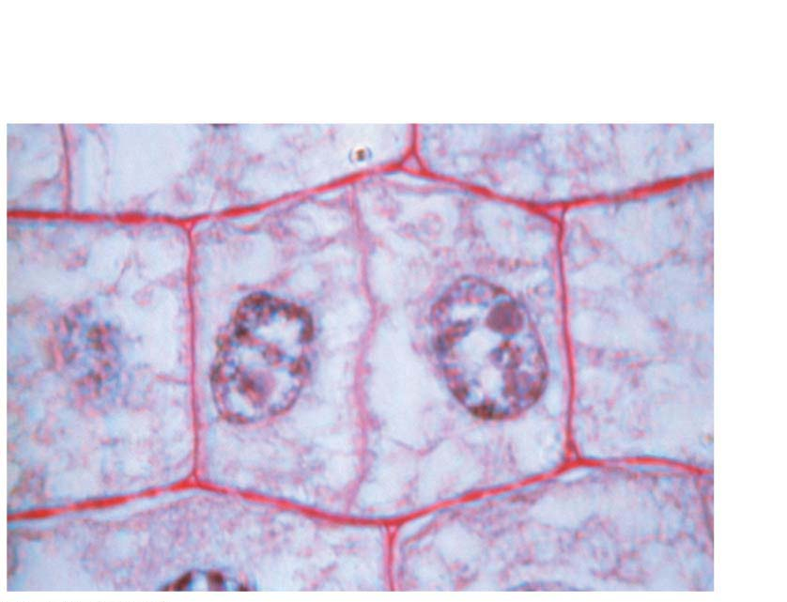
Figure 8.8-2a
Wall of
parent cell
Cell plate
forming
Daughter
nucleus
LM
Notes:
Figure 8.8-2a Cytokinesis in animal and plant cells (part 2a: plant cell, LM)

Slide 43
Cancer Cells: Dividing Out of Control
For a plant or animal to grow and maintain its tissues normally, it must be able to control the timing of cell division.
The sequential events of the cell cycle are directed by a cell cycle control system that consists of specialized proteins within the cell. These proteins
integrate information from the environment and from other body cells and
send “stop” and “go-ahead” signals at certain key points during the cell cycle.
Notes:
43

Slide 44
What Is Cancer?
Cancer is a disease of the cell cycle.
Cancer cells
do not respond normally to the cell cycle control system,
divide excessively, and
may invade other tissues of the body.
Notes:
44

Slide 45
What Is Cancer?
The abnormal behavior of cancer cells begins when
a single cell undergoes genetic changes (mutations（突变）) in one or more genes that encode for proteins in the cell cycle control system and
these changes cause the cell to grow abnormally.
Notes:
45

Slide 46
What Is Cancer?
Cancer cells can form tumors（肿瘤）, abnormally growing masses of body cells.
If the abnormal cells remain at the original site, the lump is called a benign tumor（良性肿瘤）.
Malignant tumors（恶性肿瘤） can spread into neighboring tissues and other parts of the body, forming new tumors, and can interrupt organ function.
A malignant tumor is commonly-called cancer.
The spread of cancer cells beyond their original site is called metastasis（转移）.
Mal = bad or evil (malignant: type of tumor that migrates away from its site of origin)
Notes:
46

Slide 47
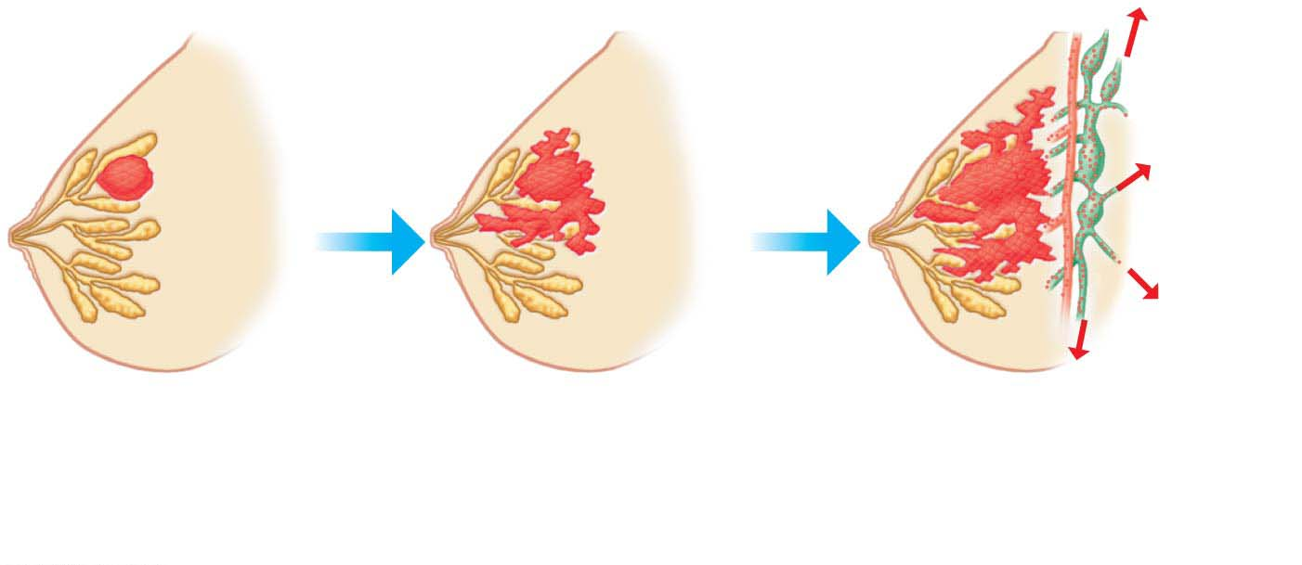
Figure 8.9
Lymph
（淋巴）
vessels
Tumor
Blood
vessel
Glandular
tissue
A tumor grows from
a single cancer cell.
Cancer cells invade
neighboring tissue.
Metastasis: Cancer cells
spread through lymph
and blood vessels to
other parts of the body.
Notes:
Figure 8.9 Growth and metastasis of a malignant tumor of the breast

Slide 48
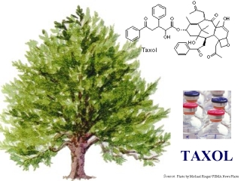
Cancer Treatment
There are three main types of cancer treatment.
Surgery to remove a tumor is usually the first step.
In radiation therapy, parts of the body that have cancerous tumors are exposed to concentrated beams of high-energy radiation, which often harm cancer cells more than normal cells. Radiation therapy is often effective against malignant tumors that have not yet spread.
Chemotherapy, the use of drugs to disrupt cell division, is used to treat widespread or metastatic tumors.
Pacific yew
Notes:
48

Slide 49
Cancer Prevention and Survival
Although cancer can strike anyone, there are certain lifestyle changes you can make to reduce your chances of developing cancer or increase your chances of surviving it. These include
not smoking,
exercising adequately,
avoiding exposure to the sun,
eating a high-fiber, low-fat diet,
performing self-exams, and
regularly visiting a doctor to identify tumors early.
Notes:
49

Slide 50
Cancer vaccine
A cancer vaccine is a vaccine that either treats existing cancer or prevents development of a cancer. Vaccines that treat existing cancer are known as therapeutic cancer vaccines.
Human papilloma virus (HPV) vaccines (人乳头状瘤病毒) are vaccines that prevent infection by certain types of human papillomavirus. Available vaccines protect against either two, four, or nine types of HPV. All vaccines protect against at least HPV type 16 and 18 that cause the greatest risk of cervical cancer (宫颈癌). Vaccinating girls around the ages of nine to thirteen is typically recommended.

Slide 51
Meiosis, the Basis of Sexual Reproduction
Sexual reproduction
produces offspring that contain a unique combination of genes from the parents and
depends on the cellular processes of meiosis and fertilization.
Notes:
51

Slide 52
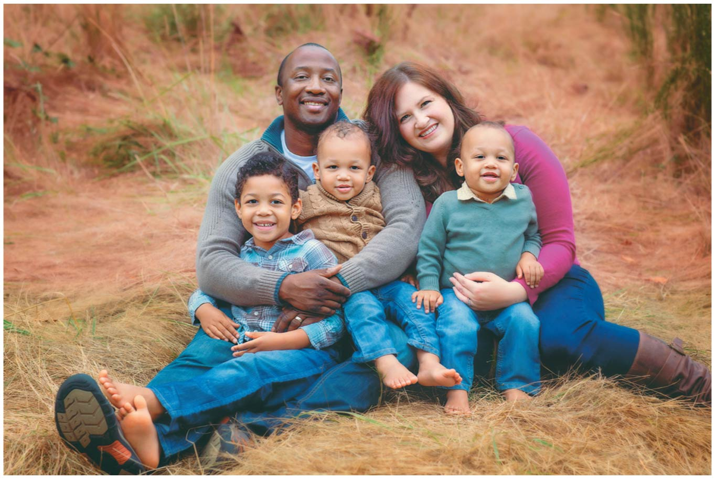
Figure 8.10
Notes:
Figure 8.10 The varied products of sexual reproduction

Slide 53
Homologous Chromosomes（同源染色体）
Different individuals of a single species have the same number and types of chromosomes.
A human somatic cell（体细胞）
is a typical body cell and
has 46 chromosomes.
soma= body (somatic: body cells with 46 chromosomes in humans)
Notes:
53

Slide 54
Homologous Chromosomes
To produce a karyotype（核型）, a technician can
break open a human cell in metaphase of mitosis,
stain the chromosomes with dyes,
take a picture with the aid of a microscope, and
arrange the chromosomes in matching pairs by size.
karyo = nucleus (karyotype: a display of the chromosomes of a cell)
Notes:
54

Slide 55
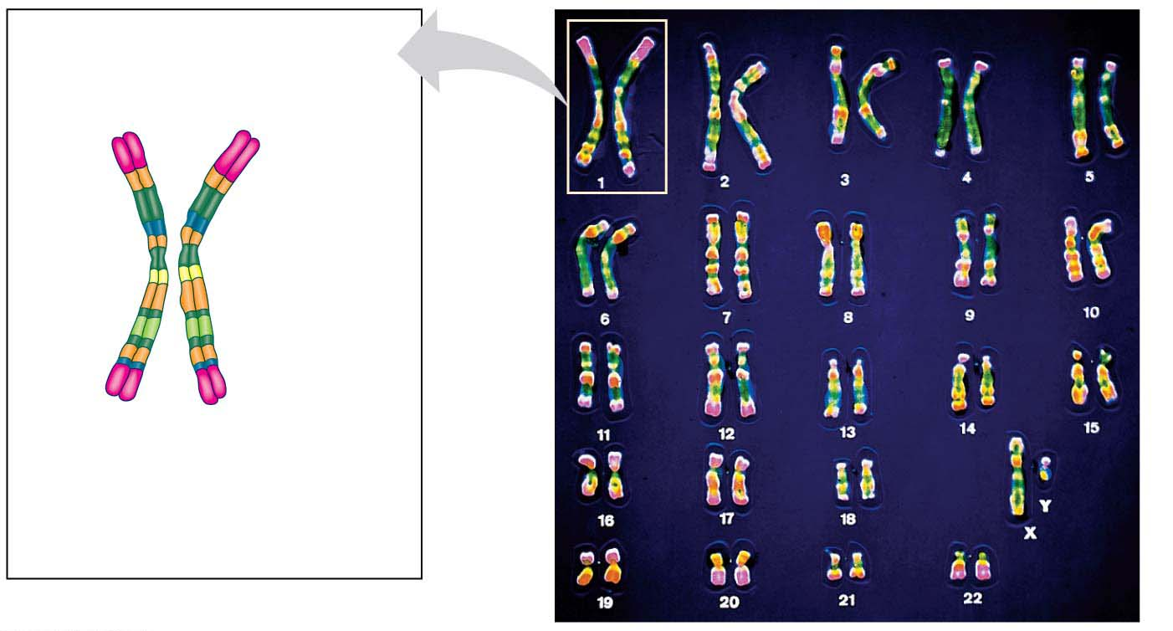
Pair of homologous
chromosomes
LM
Centromere
Sister
chromatids
One
duplicated
chromosome
homo = like (homologous: like chromosomes that form a pair)
Notes:
Figure 8.11 Pairs of homologous chromosomes in a human male karyotype

Slide 56
Homologous Chromosomes
Homologous chromosomes
resemble each other in length and centromere position and
carry genes controlling the same inherited characteristics.
homo = like (homologous: like chromosomes that form a pair)
Notes:
56

Slide 57
Homologous Chromosomes
Humans have 46 chromosomes:
22 pairs of matching chromosomes, called autosomes（常染色体）, and
two different sex chromosomes（性染色体）, X and Y, which determine a person’s sex (male or female).
In mammals,
males have one X chromosome and one Y chromosome and
females have two X chromosomes.
auto= self (autosomes: the chromosomes that do not determine gender)
Notes:
57

Slide 58
Gametes and the Life Cycle of a Sexual Organism
The life cycle of a multicellular organism is the sequence of stages leading from the adults of one generation to the adults of the next.
Having two sets of chromosomes, one inherited from each parent, is a key factor in the life cycle of humans and all other species that reproduce sexually.
Notes:
58

Slide 59
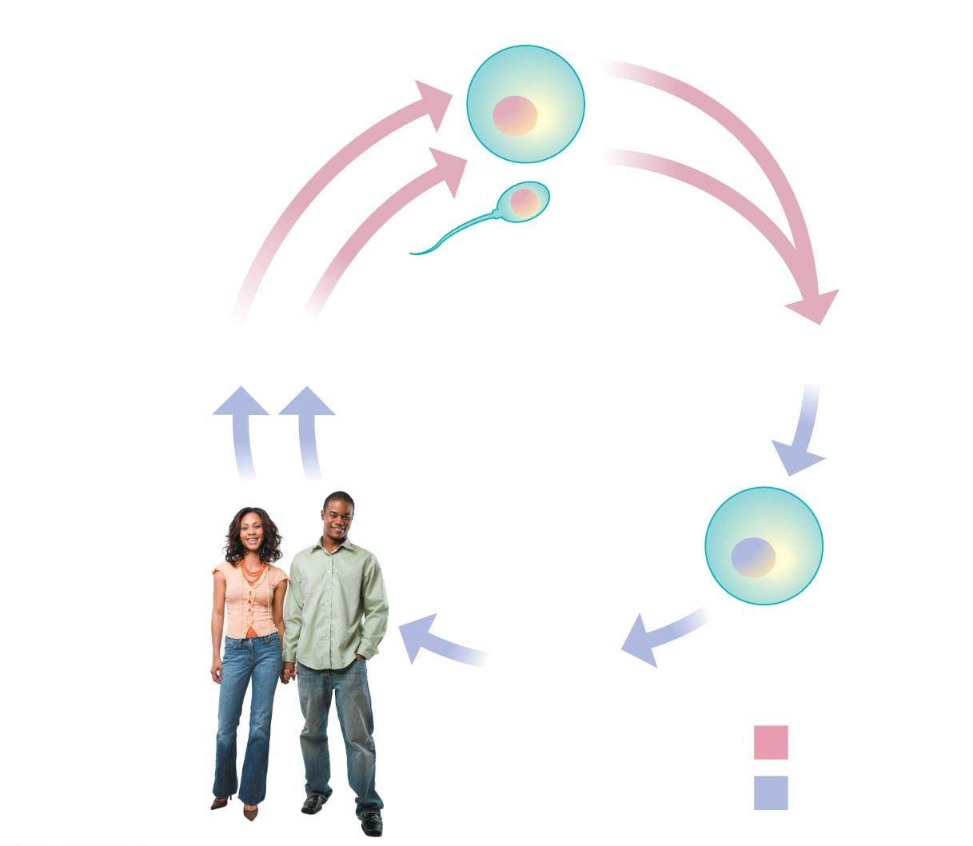
Haploid gametes (n = 23)
n
Egg cell
n
Sperm cell
MEIOSIS
FERTILIZATION
Multicellular
diploid adults
(2n = 46)
Diploid
zygote
(2n = 46)
2n
（Zygote: 受精卵）
MITOSIS
and development
Key
Haploid (n)（单倍体）
Diploid (2n)（二倍体）
Notes:
Figure 8.12 The human life cycle

Slide 60
Gametes and the Life Cycle of a Sexual Organism
Humans are said to be diploid organisms because all body cells contain pairs of homologous chromosomes.
A haploid cell has only one member of each pair of homologous chromosomes.
di= two (diploid: cells that contain two homologous sets of chromosomes)
haplo = single (haploid: cells that contain only one chromosome of each homologous pairs)
Notes:
60

Slide 61
Gametes and the Life Cycle of a Sexual Organism
In the human life cycle, a haploid sperm cell from the father fuses with a haploid egg cell from the mother in a process called fertilization.
The resulting fertilized egg, called a zygote, is diploid, with two sets of chromosomes, one set from each parent.
Notes:
61

Slide 62
Gametes and the Life Cycle of a Sexual Organism
All sexual life cycles involve an alternation of diploid and haploid stages.
Producing haploid gametes by meiosis keeps the chromosome number from doubling in every generation.
Notes:
62

Slide 63
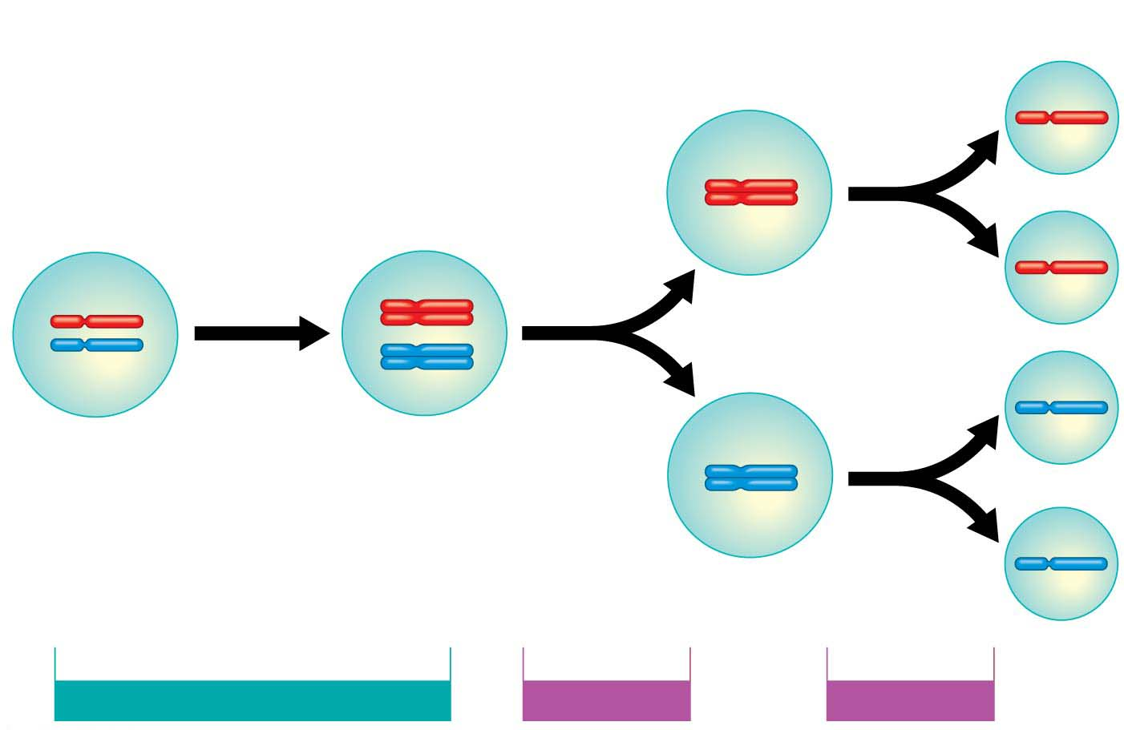
1
Chromosomes
duplicate.
2
Homologous
chromosomes
separate.
3
Sister chromatids
separate.
Pair of
homologous
chromosomes
in diploid
parent cell
A pair of
homologous
chromosomes
Sister
chromatids
INTERPHASE BEFORE MEIOSIS
MEIOSIS I
MEIOSIS II
Notes:
Figure 8.13-s3 How meiosis halves chromosome number (step 3)

Slide 64
The Process of Meiosis
Meiosis, the process of cell division that produces haploid gametes in diploid organisms, resembles mitosis, but with two differences.
The first difference is that the number of chromosomes during meiosis is cut in half.
In meiosis, a cell that has duplicated its chromosomes undergoes two consecutive divisions, called meiosis I and meiosis II.
Because one duplication of the chromosomes is followed by two divisions, each of the four daughter cells resulting from meiosis has a haploid set of chromosomes.
Notes:
64

Slide 65
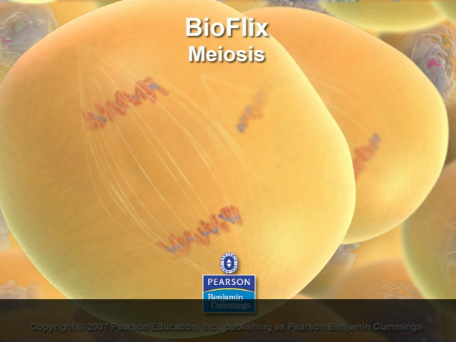
Bioflix Animation: Meiosis

Slide 66
The Process of Meiosis
The second difference of meiosis compared with mitosis is an exchange of genetic material—pieces of chromosomes—between homologous chromosomes.
This exchange, called crossing over, occurs during the first prophase of meiosis.
Notes:
66

Slide 67
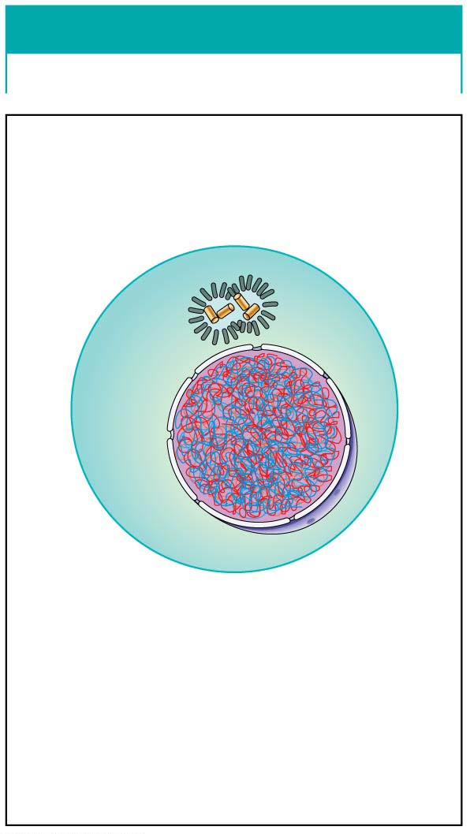
INTERPHASE
Centrosomes
Nuclear
envelope
Uncondensed
chromosomes
Chromosomes duplicate.
Notes:
Figure 8.14-1 The stages of meiosis (part 1: interphase)

Slide 68
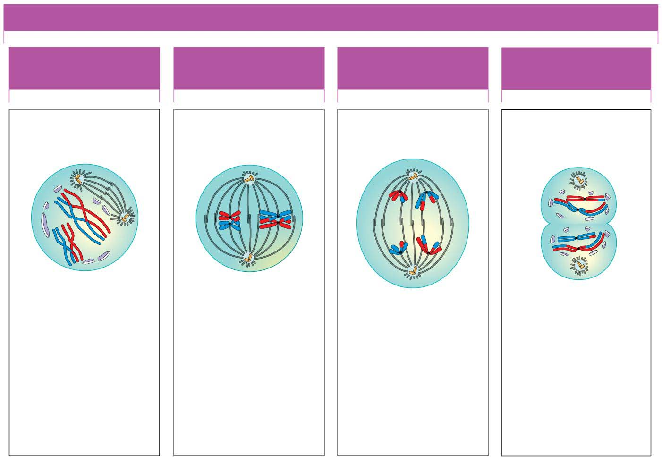
MEIOSIS I: HOMOLOGOUS CHROMOSOMES SEPARATE
PROPHASE I
METAPHASE I
ANAPHASE I
TELOPHASE I AND
CYTOKINESIS
One diploid cell
Sites of
crossing over
Spindle tracks
attached to
chromosome
Sister chromatids
remain attached
Cleavage
furrow
n
2n
Spindle
Sister
chromatids
Centromere
Homologous chromosomes randomly separate and migrate to opposite poles
n
Pair of
homologous
chromosomes
Homologous
chromosomes
pair up and
exchange
segments.
Pairs of
homologous
chromosomes
line up.
Pairs of
homologous
chromosomes
split up.
Two haploid
cells form;
chromosomes
are still doubled.
Notes:
Figure 8.14-2 The stages of meiosis (part 2: meiosis I)

Slide 69
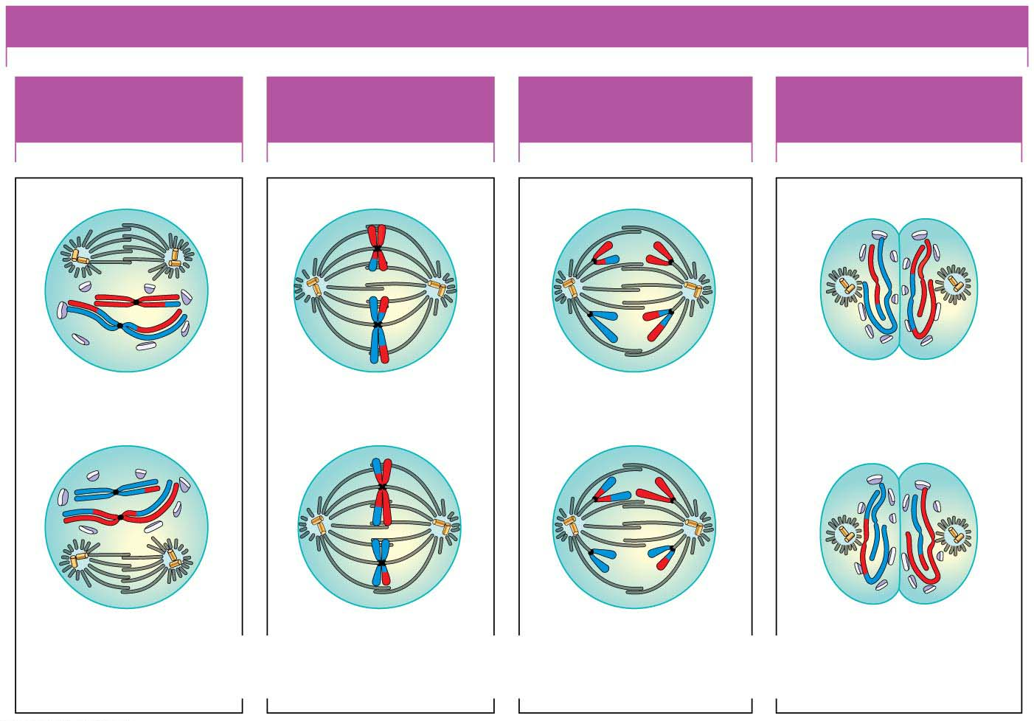
MEIOSIS II: SISTER CHROMATIDS SEPARATE
PROPHASE II
METAPHASE II
ANAPHASE II
TELOPHASE II AND
CYTOKINESIS
n
n
n
Sister chromatids
separate
Haploid daughter
cells forming
n
n
n
During another round of cell division, the sister chromatids finally separate;
four haploid daughter cells result, containing single chromosomes.
Notes:
Figure 8.14-3 The stages of meiosis (part 3: meiosis II)

Slide 70
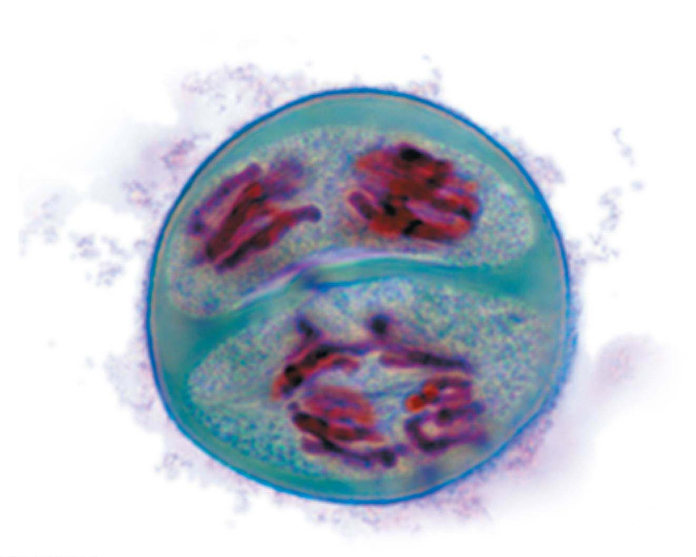
Meiosis II in a lily cell
LM
Notes:
Figure 8.14-3c The stages of meiosis (part 3c: lily cell)

Slide 71
Review: Comparing Mitosis and Meiosis
For both mitosis and meiosis, the chromosomes duplicate only once, in the preceding interphase.
The number of cell divisions varies:
Mitosis involves one division of the nucleus and cytoplasm (duplication, then division in half), producing two diploid cells.
Meiosis entails two nuclear and cytoplasmic divisions (duplication, division in half, then division in half again), yielding four haploid cells.
Notes:
71

Slide 72
Review: Comparing Mitosis and Meiosis
All the events unique to meiosis occur during meiosis I.
Meiosis II is virtually identical to mitosis in that it separates sister chromatids.
But unlike mitosis, meiosis II yields daughter cells with a haploid set of chromosomes.
Notes:
72

Slide 73
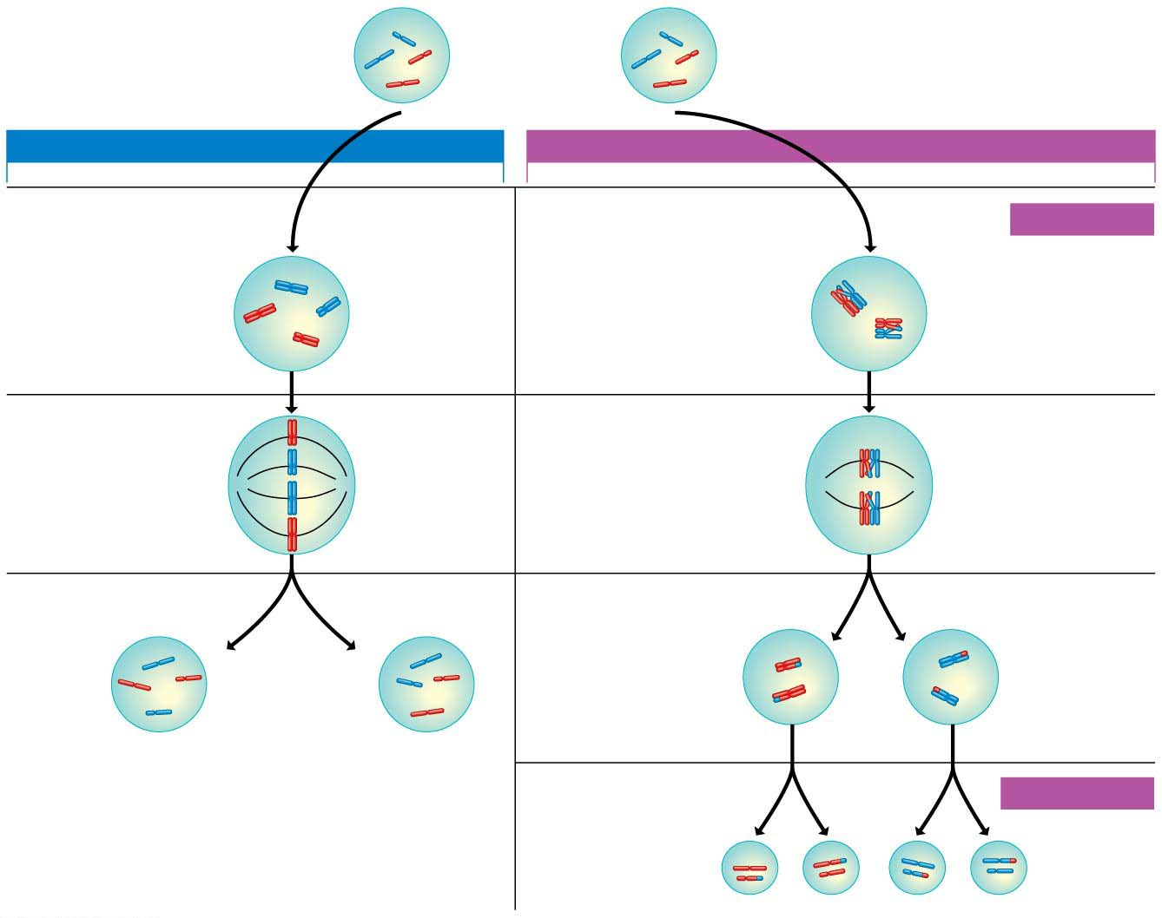
Parent cell
2n = 4
Parent cell
2n = 4
MITOSIS
MEIOSIS
Prophase
Prophase I
MEIOSIS I
Duplicated
chromosome
Homologous
chromosomes
come together.
Site of
crossing over
Metaphase
Metaphase I
Chromosomes
align.
Homologous
pairs align.
Anaphase
Telophase
Anaphase I
Telophase I
Sister
chromatids
separate.
Homologous
chromosomes
separate.
Haploid
n = 2
2n
2n
Sister
chromatids
separate.
MEIOSIS II
n
n
n
n
Notes:
Figure 8.15 Comparing mitosis and meiosis

Slide 74
The Origins of Genetic Variation
Offspring of sexual reproduction are genetically different from their parents and one another.
How does meiosis produce such genetic variation?
Notes:
74

Slide 75
Independent Assortment of Chromosomes
Figure (on next page) illustrates one way in which meiosis contributes to genetic variety.
When aligned during metaphase I of meiosis, the side-by-side orientation of each homologous pair of chromosomes is a matter of chance.
For a species with more than two pairs of chromosomes, such as humans, every chromosome pair orients independently of all the others at metaphase I.
Notes:
75

Slide 76
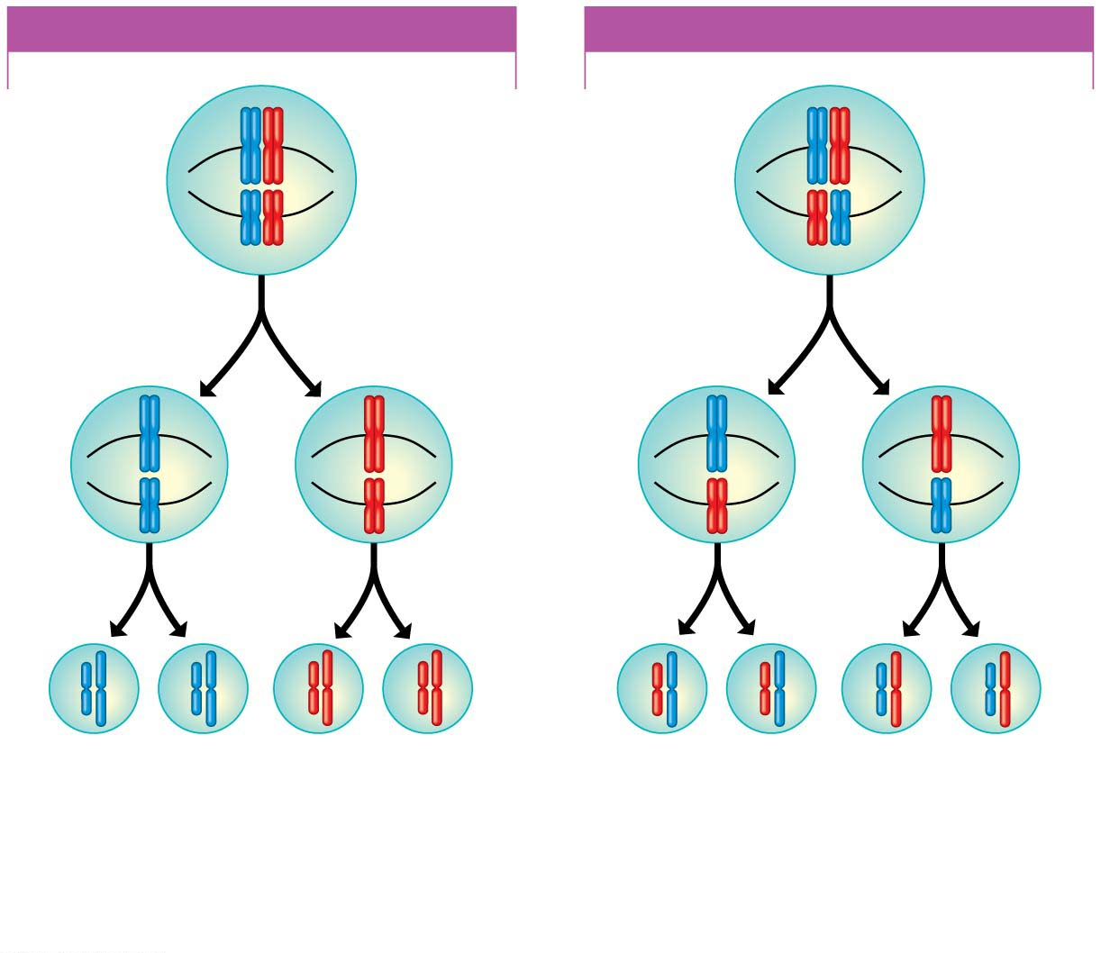
POSSIBILITY 1
POSSIBILITY 2
Two equally probable
arrangements of
chromosomes
at metaphase of
meiosis I
Metaphase
of
meiosis II
Gametes
Combination a
Combination b
Combination c
Combination d
Because possibilities 1 and 2 are equally likely, the four possible types
of gametes will be made in approximately equal numbers.
Notes:
Figure 8.16 Results of alternative arrangements of chromosomes at metaphase of meiosis I

Slide 77
Independent Assortment of Chromosomes
For a human, n = 23, so there are 2²³, or about 8 million, possible chromosome combinations that can appear in gametes.
A single man and a single woman can produce zygotes with 64 trillion combinations of chromosomes!
Notes:
77

Slide 78
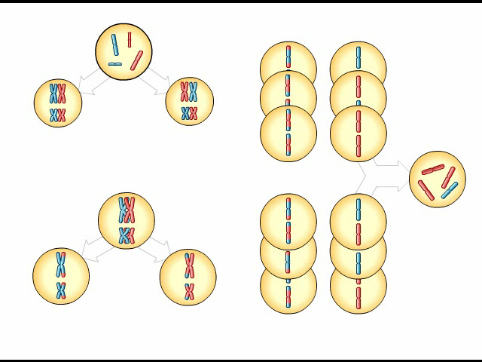
Animation: Genetic Variation

Slide 79
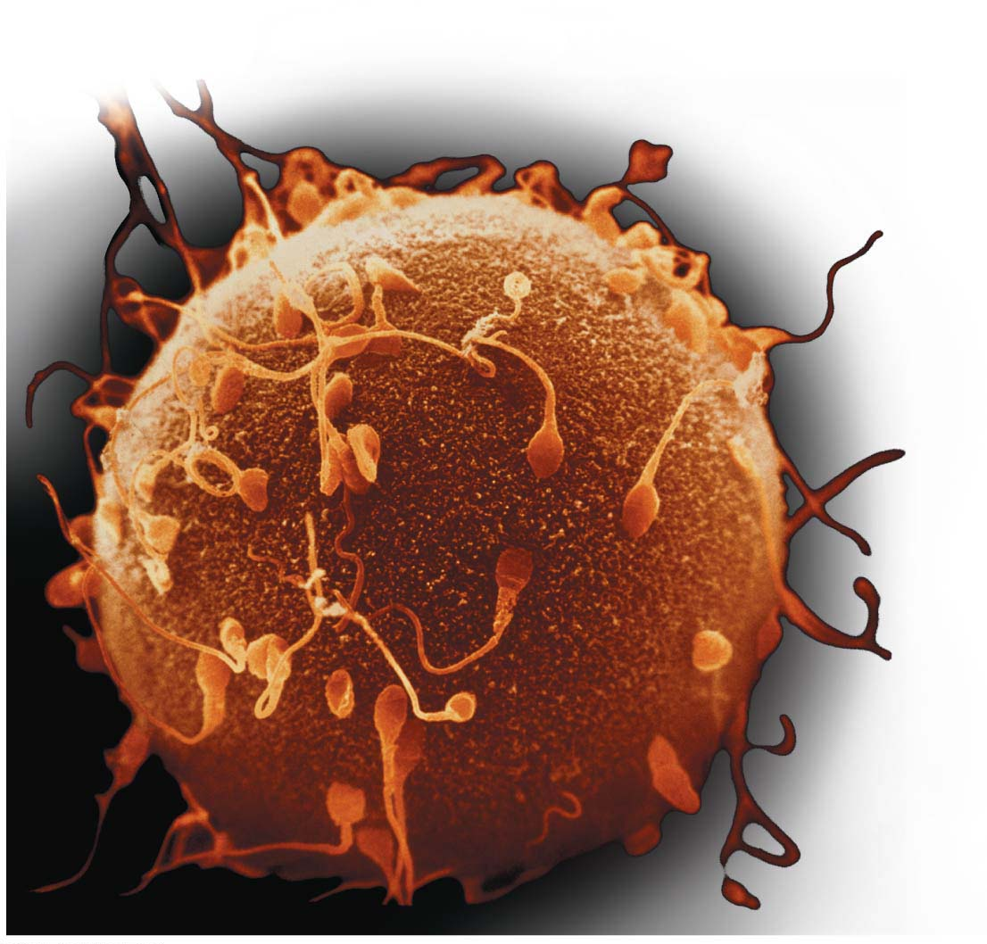
Figure 8.17
Colorized LM
Notes:
Figure 8.17 The process of fertilization: a close-up view

Slide 80
Crossing Over
Crossing over（交换） is the exchange of corresponding segments between nonsister chromatids of homologous chromosomes, which occurs during prophase I of meiosis.
With crossing over, gametes arise with chromosomes that are partly from the mother and partly from the father.
Notes:
80

Slide 81
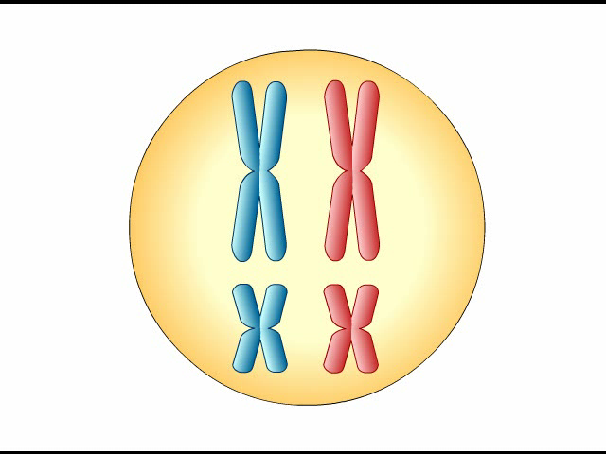
Animation: Crossing Over

Slide 82
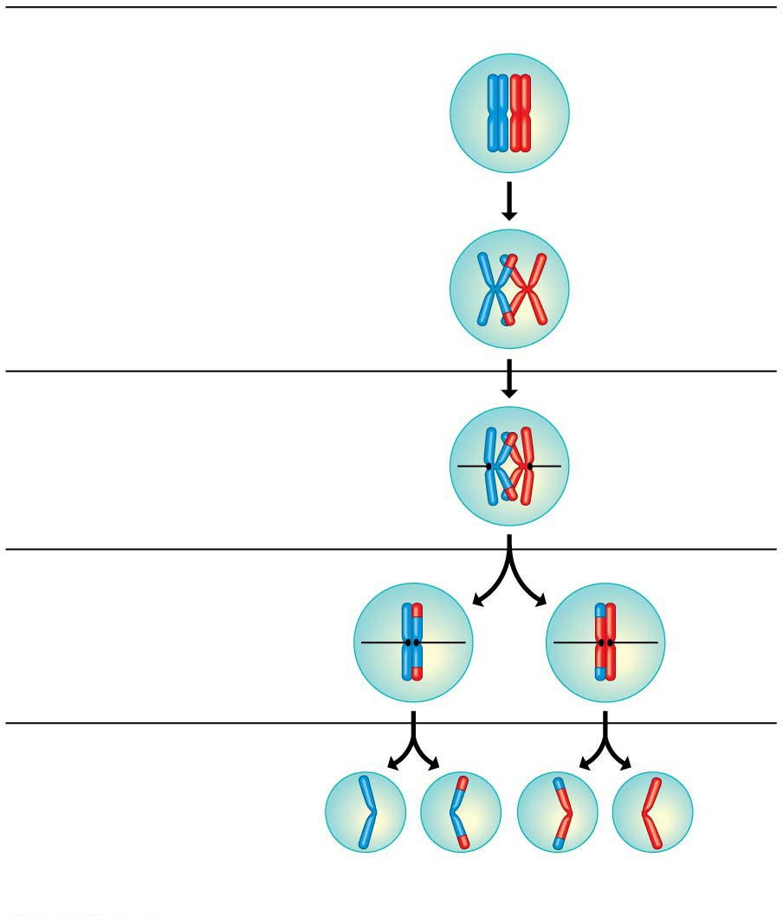
Prophase I of meiosis
Duplicated pair
of homologous
chromosomes
Homologous
(nonsister) chromatids
exchange corresponding
segments.
Site of
crossing over
Metaphase I
Sister chromatids
remain joined at
their centromeres.
Spindle
Metaphase II
Gametes
Recombinant
chromosomes combine
genetic information
from different parents.
Recombinant chromosomes
Notes:
Figure 8.18 The results of crossing over during meiosis for a single pair of homologous chromosomes

Slide 83
The Process of Science: Do All Animals Have Sex?
Although some animal species can reproduce asexually, very few animals reproduce only asexually.
Observation: No one had ever found bdelloid rotifer(BF)（蛭形轮虫） males or evidence of sexual reproduction.
Question: Does this entire class of animals reproduce solely by asexual means?
Notes:
83

Slide 84
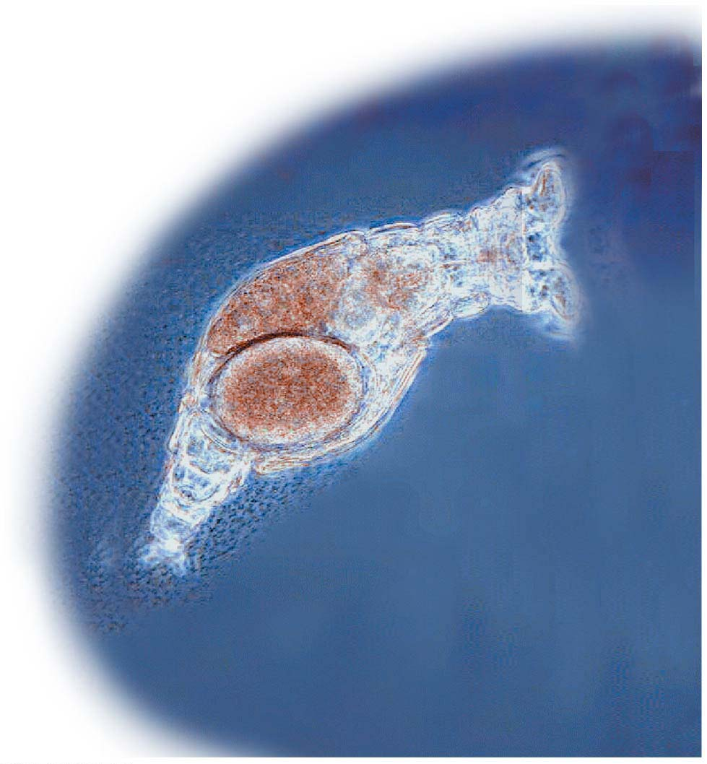
LM
Notes:
Figure 8.19 A bdelloid rotifer

Slide 85
The Process of Science: Do All Animals Have Sex?
Hypothesis: Bdelloid rotifers (BF) have thrived for millions of years without sexually reproducing.
Prediction: Bdelloid rotifers would display much more variation in their pairs of homologous genes than most organisms.
Experiment: Researchers compared the sequences of a particular gene in bdelloid and non-bdelloid rotifers.
Notes:
85

Slide 86
The Process of Science: Do All Animals Have Sex?
Results:
Among non-bdelloid rotifers (BF) that reproduce sexually, the two homologous versions of the gene were nearly identical, differing by only 0.5% on average.
In contrast, the two versions of the same gene in bdelloid rotifers (BF) differed by 3.5–54%.
These data provided strong evidence that bdelloid rotifers (BF) have evolved for millions of years without any sexual reproduction.
Notes:
86

Slide 87
When Meiosis Goes Awry
What happens when there is an error in the process of meiosis?
Such a mistake can result in genetic abnormalities that range from mild to severe to fatal.
Notes:
87

Slide 88
How Accidents during Meiosis Can Alter Chromosome Number
In nondisjunction（不分离）, the members of a chromosome pair fail to separate at anaphase, producing gametes with abnormal numbers of chromosomes.
Nondisjunction can occur during meiosis I or II.
Notes:
88

Slide 89
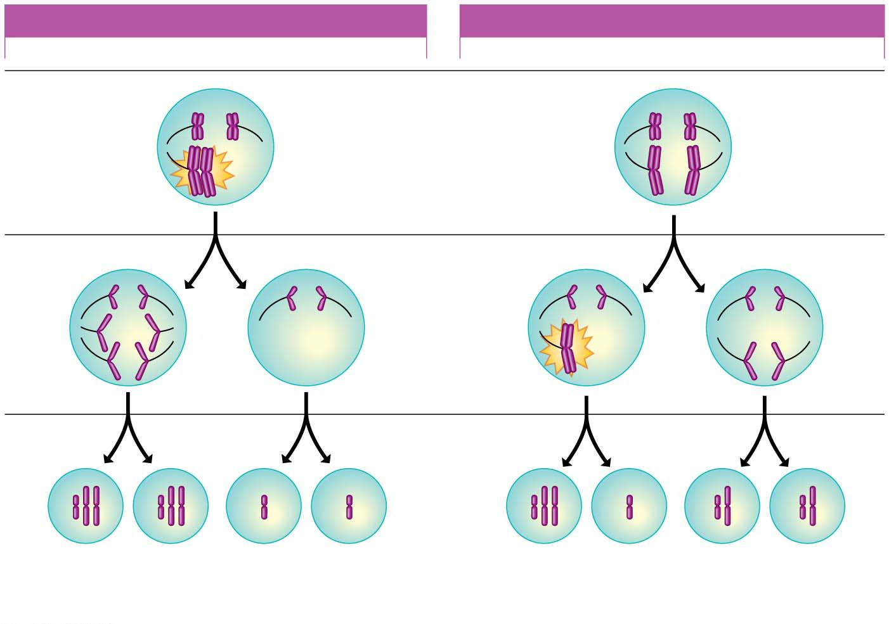
NONDISJUNCTION IN MEIOSIS I
NONDISJUNCTION IN MEIOSIS II
Meiosis I
Homologous
chromosomes
fail to separate.
Meiosis II
Sister
chromatids
fail to
separate.
Gametes
n + 1
n + 1
n − 1
n − 1
n + 1
n − 1
n
n
Abnormal
Abnormal
Normal
Notes:
Figure 8.20-s3 Two types of nondisjunction (step 3)

Slide 90
How Accidents during Meiosis Can Alter Chromosome Number
Figure 8.21 shows what can happen when an abnormal gamete produced by nondisjunction unites with a normal gamete during fertilization.
When a normal sperm fertilizes an egg cell with an extra chromosome, the result is a zygote with a total of 2n + 1 chromosomes.
Notes:
90
Student Misconceptions and Concerns
1. How meiosis results in four haploid cells yet mitosis yields two diploid cells is often memorized but not understood. It can be explained like this. In mitosis and meiosis, the processes begin with replicated pairs of chromosomes. The two pairs include four items. Sort this group into two subgroups, and you are back to two pairs. Divide again, and you have separated four items into four groups of one. All of the details of these two processes, although eventually addressed, can get in the way of seeing the overall process.
2. Most people have difficulty comprehending large numbers. See Teaching Tips 7–9 below to help relate these large numbers to aspects of students’ lives.
Teaching Tips
1. Consider helping students through mitosis and meiosis by developing an analogy to pairs of shoes. In this case, any given species that is diploid has a certain number of pairs of shoes, or homologous chromosomes.
2. In the shoe analogy, females have 23 pairs of matching shoes, and males have 22 matching pairs and one odd pair—maybe a sandal and a sneaker!
3. You may wish to ask the class why meiosis is necessary. Why not have a male diploid cell fertilize a diploid female cell? In short, the answer is that, if this were true, at every fertilization, we would have genetic doubling.
4. If you wish to continue the shoe analogy, crossing over is somewhat like exchanging the shoelaces in a pair of shoes. A point to make is that the shoes (chromosomes) before crossing over are what you inherited—from either the sperm or the egg; but as a result of crossing over, you no longer pass along exactly what you inherited. Instead, you pass along a combination of homologous chromosomes (or shoes with switched shoelaces). In this shoe analogy, after exchanging shoelaces, we have recombinant shoes!
5. You might consider emphasizing a crucial difference between the processes of mitosis and meiosis. In mitosis, sister chromatids separate at metaphase. In meiosis I metaphase, sister chromatids stay together, and homologous chromosomes separate. After discussing mitosis and meiosis in class, consider asking your students to sketch the alignment of the chromosomes at mitosis metaphase and meiosis I metaphase.
6. The number 2²³ is 8,388,608. This number squared is more than 70 trillion. The authors rounded down to 8 million for 2²³ and squared this to estimate 64 trillion possible combinations. But more precisely, the number of possible zygotes produced by a single pair of reproducing humans, based solely on independent assortment and random fertilization, is over 70 trillion!
7. There are currently about 320 million humans living in the United States. If every person in the United States received about $217,000, it would equal $70 trillion. Here is another way to think of it. If you lived to be 100 years old and spent $22,181.66 every second of your life, (or a million dollars every 45 seconds) you would spend about $70 trillion dollars.
8. The impressive nature of such large numbers is lost on most of us who cannot comprehend such quantities. There are about 64 trillion seconds in 2 million years (actually, 2,028,000 years).
9. Depending on the size of your class, it is likely that at least one of your students has a friend or relative with Down syndrome. A student in your class may even enjoy the chance to talk about their friend or relative.
Active Lecture Tips
1. Sometimes the most basic questions can challenge students and get them focused on the subject at hand. Consider asking your students to work with other students near them to consider why we expect that dogs produce dogs, cats produce only more cats, and chickens only produce chickens. Why does “like produce like”?
2. See the Activity Student Demonstration of Mitosis and Meiosis Using Chromosome Cut-Outs as Models on the Instructor Exchange. Visit the Instructor Exchange in the MasteringBiology instructor resource area for a description of this activity.
3. See the Activity Applying the Concept of Nondisjunction to Trisomy on the Instructor Exchange. Visit the Instructor Exchange in the MasteringBiology instructor resource area for a description of this activity.

Slide 91
How Accidents during Meiosis Can Alter Chromosome Number
Because mitosis duplicates the chromosomes as they are, the abnormality will be passed to all embryonic cells.
If the organism survives, it will have an abnormal karyotype and probably a syndrome of disorders caused by the abnormal number of genes.
Notes:
91

Slide 92
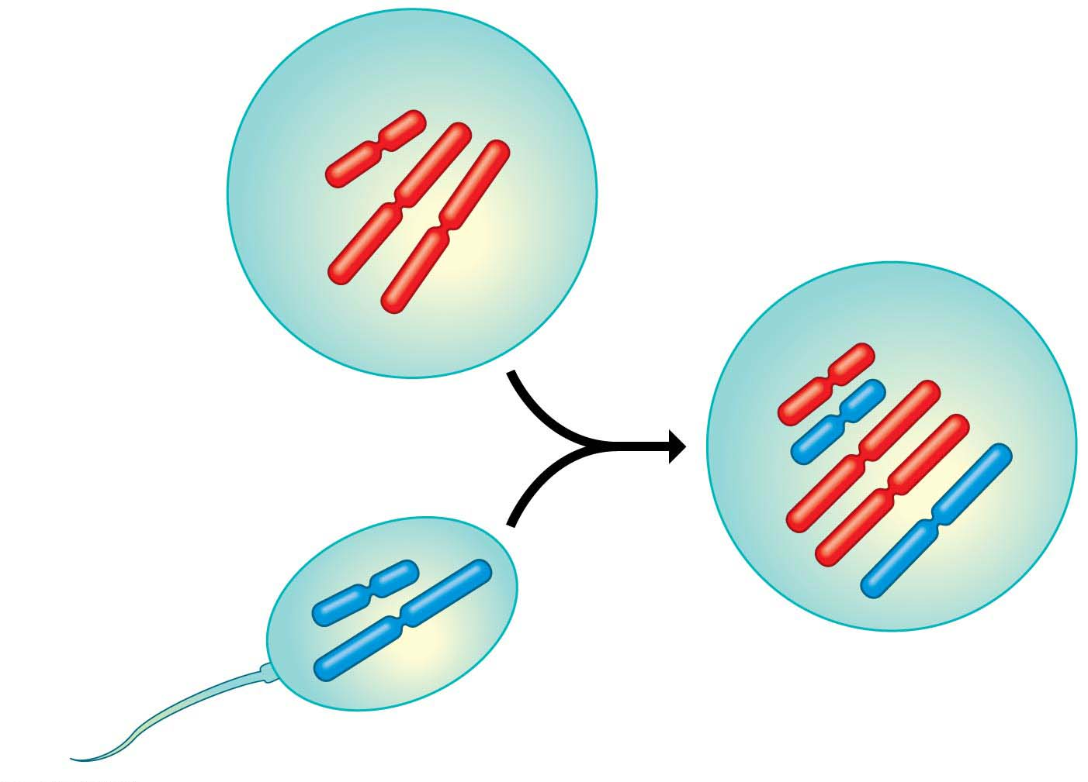
Figure 8.21
Abnormal egg
cell with extra
chromosome
n + 1
Normal
sperm cell
Abnormal zygote with
extra chromosome
2n + 1
n (normal)
Notes:
Figure 8.21 Fertilization after nondisjunction in the mother

Slide 93
Down Syndrome: An Extra Chromosome 21
In a condition called trisomy 21（21-三体综合征）, there are three number 21 chromosomes, making 47 chromosomes in total.
A person with trisomy 21 has a condition called Down syndrome（唐氏症）, which
affects about 1 out of every 700 children,
is the most common chromosome number abnormality, and
is the most common serious birth defect in the United States.
Notes:
93

Slide 94
Figure 8.11
Pair of homologous
chromosomes
LM
Centromere
Sister
chromatids
One
duplicated
chromosome
Notes:
Figure 8.11 Pairs of homologous chromosomes in a human male karyotype

Slide 95
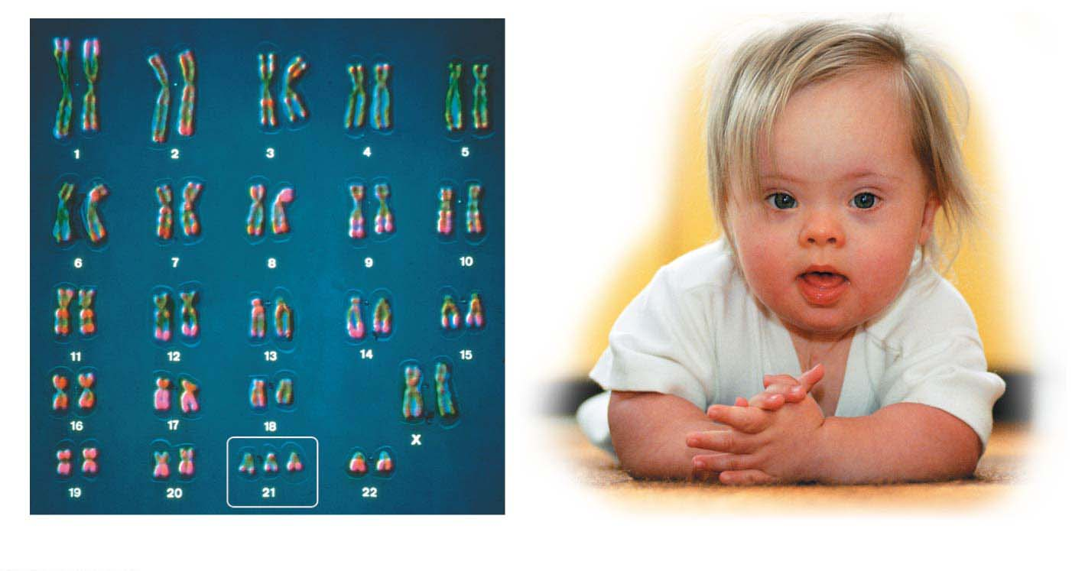
Figure 8.22
LM
Trisomy 21
Notes:
Figure 8.22 Trisomy 21 and Down syndrome

Slide 96
Down Syndrome: An Extra Chromosome 21
People with Down syndrome
have characteristic facial features,
usually have a life span shorter than normal, and
exhibit varying degrees of developmental delays.
However, some individuals may live to middle age or beyond, and many are socially adept and can function well within society.
Notes:
96

Slide 97
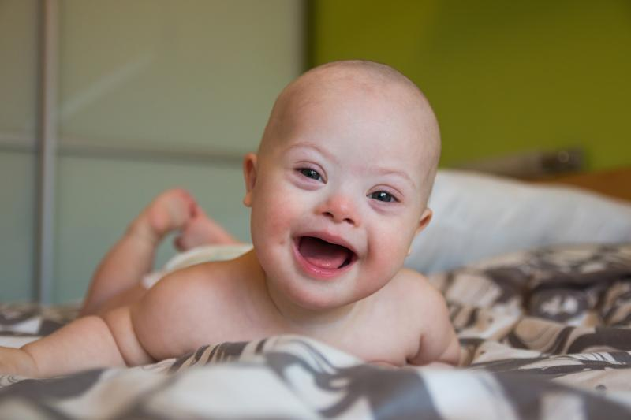

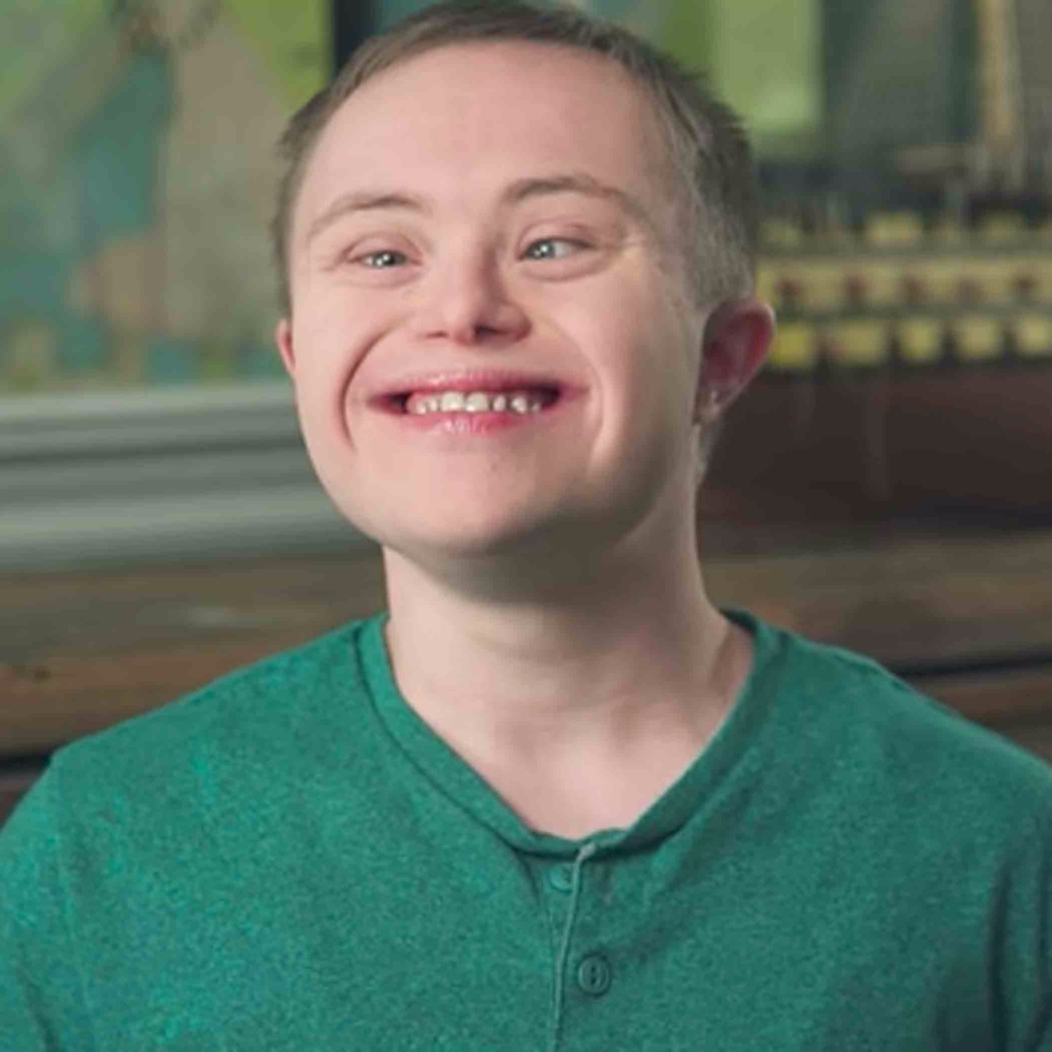
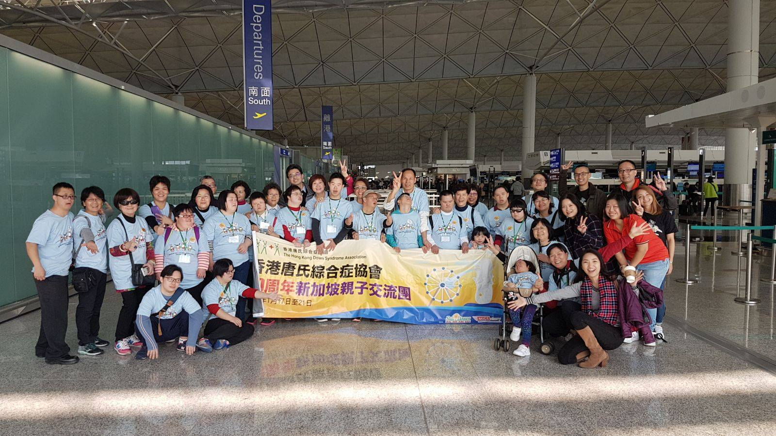
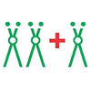

Hong Kong Down Syndrome Association

Slide 98
Down Syndrome: An Extra Chromosome 21
Although we don’t know why, the risk of Down syndrome increases with the age of the mother.
The fetuses of pregnant women age 35 and older are therefore candidates for chromosomal prenatal screenings.
Notes:
98

Slide 99
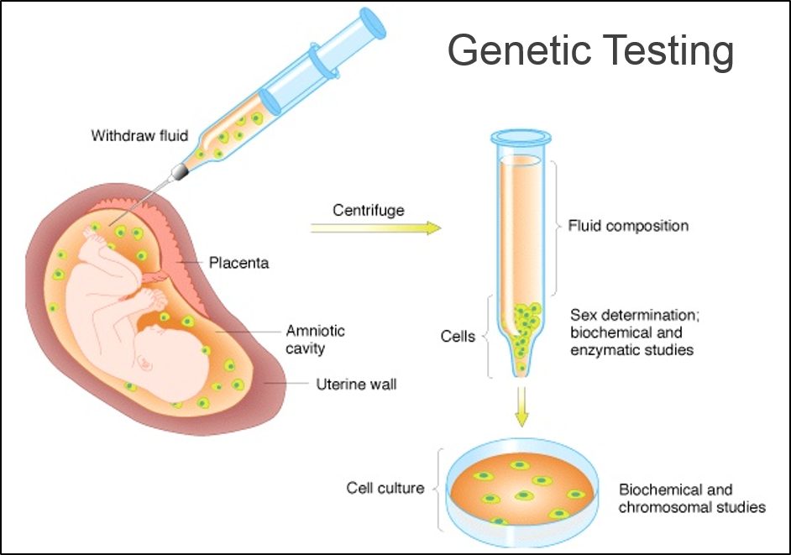
The screening test is performed from 11-13 weeks of gestation.

Slide 100
Abnormal Numbers of Sex Chromosomes
Nondisjunction in meiosis can lead to abnormal numbers of sex chromosomes, X and Y.
Unusual numbers of sex chromosomes seem to upset the genetic balance less than unusual numbers of autosomes.
Table 8.1 lists the most common human sex chromosome abnormalities.
Notes:
100

Slide 101
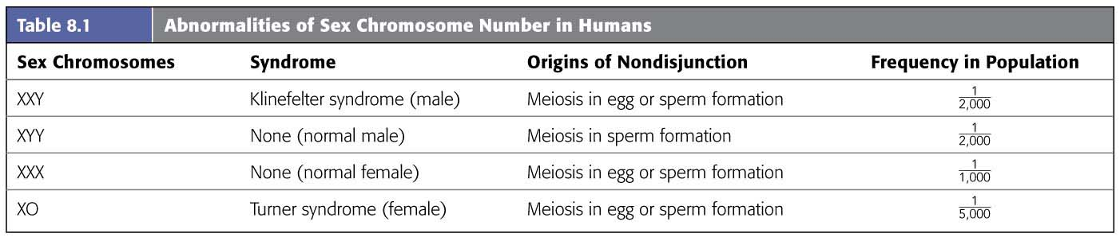
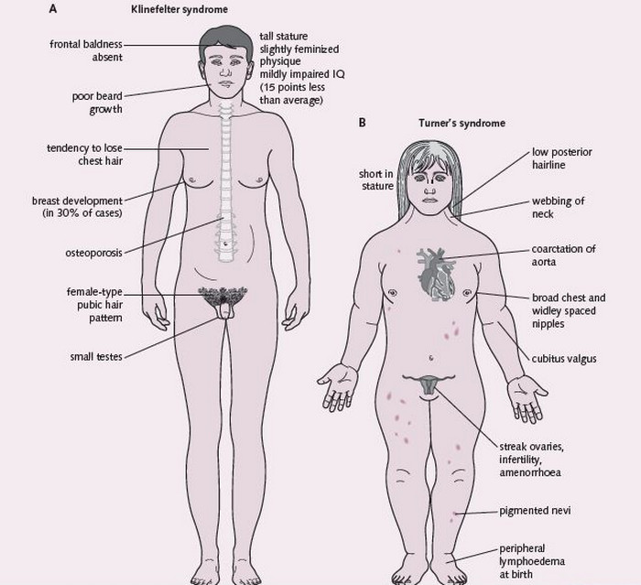
Table 8.1
Notes:
Table 8.1 Abnormalities of sex chromosome number in humans

Slide 102
Evolution Connection: The Advantages of Sex
Many species can reproduce both sexually and asexually.
Asexual reproduction
eliminates the need to expend energy forming gametes and copulating with a partner and
confers an evolutionary advantage when organisms are
sparsely distributed or
superbly suited to a stable environment.
Notes:
102

Slide 103
Evolution Connection: The Advantages of Sex
Sexual reproduction may convey an evolutionary advantage by
producing offspring of varied genetic makeup or
reducing the incidence of harmful genes more rapidly.
Notes:
103

Slide 104
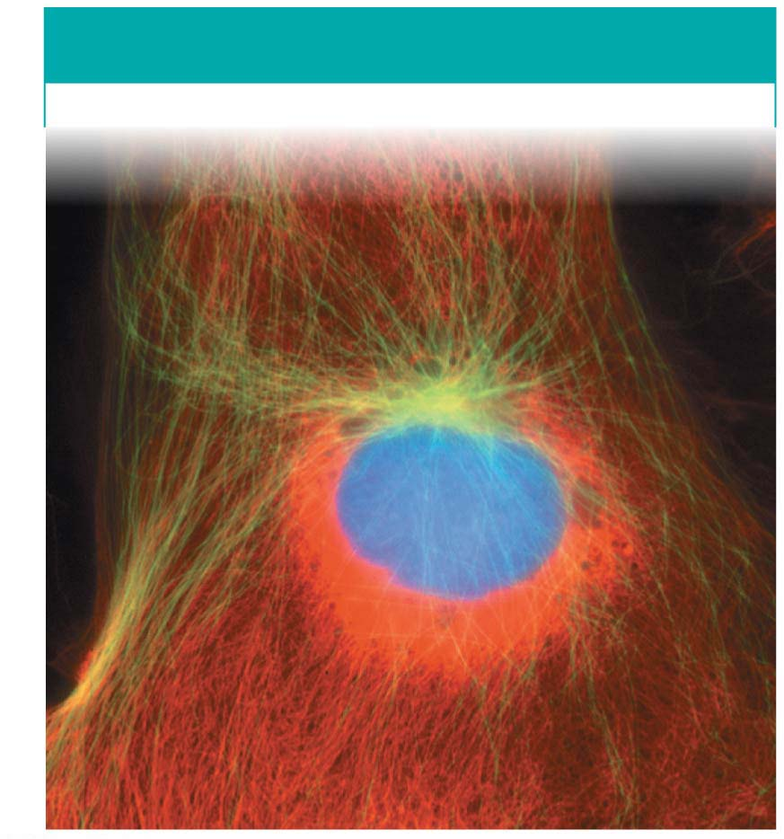
Figure 8.7-1a
INTERPHASE
LM
Notes:
Figure 8.7-1a Cell reproduction: a dance of the chromosomes (part 1a: interphase)

Slide 105
Figure 8.7-2
METAPHASE
ANAPHASE
TELOPHASE
Nuclear
envelope
forming
Cleavage
furrow
Condensed
chromosomes align
Separated
chromosomes
Notes:
Figure 8.7-2 Cell reproduction: a dance of the chromosomes (part 2: metaphase, anaphase, and telophase)

Slide 106
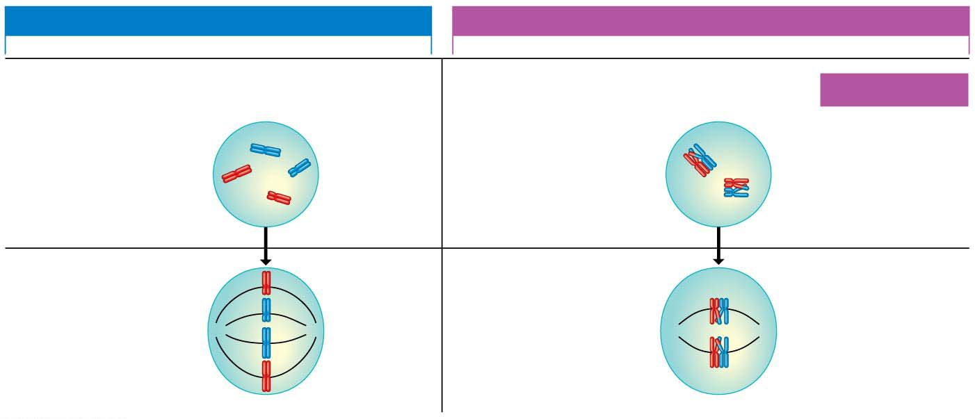
Figure 8.15-1
MITOSIS
MEIOSIS
Prophase
Prophase I
MEIOSIS I
Duplicated
chromosome
Homologous
chromosomes
come together.
Site of
crossing over
Metaphase
Metaphase I
Chromosomes
align.
Homologous
pairs align.
Notes:
Figure 8.15-1 Comparing mitosis and meiosis (part 1: prophase and metaphase)

Slide 107
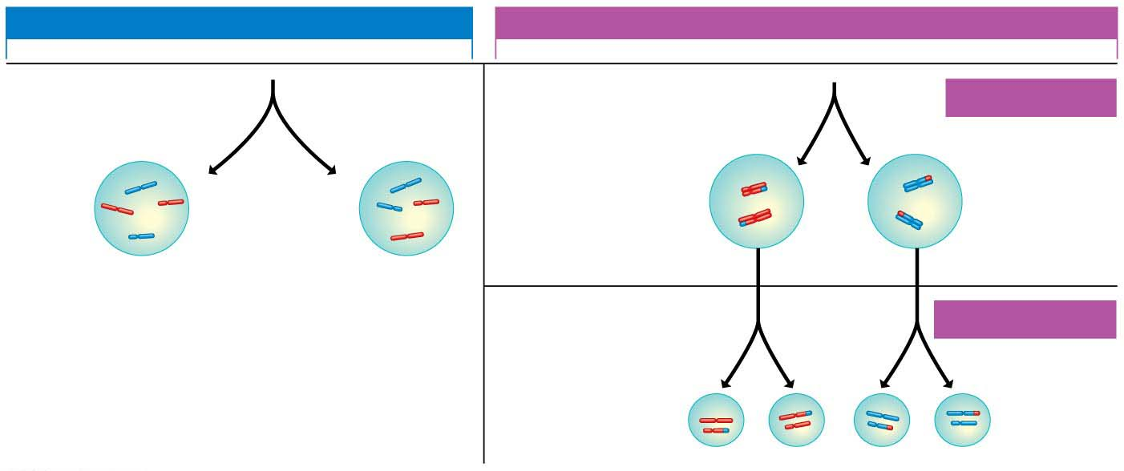
Figure 8.15-2
MITOSIS
MEIOSIS
Anaphase
Telophase
Anaphase I
Telophase I
MEIOSIS I
Sister
chromatids
separate.
Homologous
chromosomes
separate.
Haploid
n = 2
2n
2n
MEIOSIS II
Sister
chromatids
separate.
n
n
n
n
Notes:
Figure 8.15-2 Comparing mitosis and meiosis (part 2: anaphase and telophase)

Slide 108
Figure 8.16-s3
POSSIBILITY 1
POSSIBILITY 2
Two equally probable
arrangements of
chromosomes
at metaphase of
meiosis I
Metaphase
of
meiosis II
Gametes
Combination a
Combination b
Combination c
Combination d
Because possibilities 1 and 2 are equally likely, the four possible types
of gametes will be made in approximately equal numbers.
Notes:
Figure 8.16-s3 Results of alternative arrangements of chromosomes at metaphase of meiosis I (step 3)

Slide 109
Figure 8.20-s3
NONDISJUNCTION IN MEIOSIS I
NONDISJUNCTION IN MEIOSIS II
Meiosis I
Homologous
chromosomes
fail to separate.
Meiosis II
Sister
chromatids
fail to
separate.
Gametes
n + 1
n + 1
n − 1
n − 1
n + 1
n − 1
n
n
Abnormal
Abnormal
Normal
Notes:
Figure 8.20-s3 Two types of nondisjunction (step 3)

Slide 110
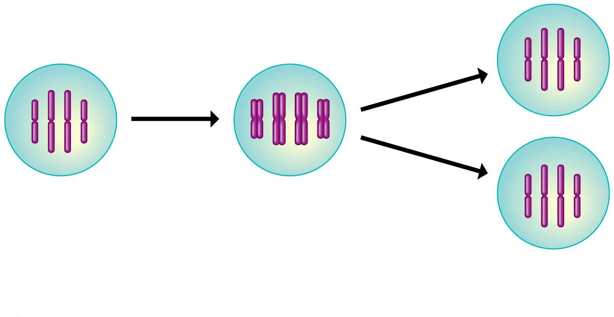
Figure 8.UN01
Distribution via
mitosis
Duplication
of all
chromosomes
Genetically
identical
daughter cells
Notes:
Figure 8.UN01 Summary of key concepts: cell division

Slide 111

Figure 8.UN02
Chromosome (one
long piece of DNA)
Centromere
Sister
chromatids
Duplicated chromosome
Notes:
Figure 8.UN02 Summary of key concepts: chromosome duplication

Slide 112

Figure 8.UN04
Human Life Cycle
Haploid gametes (n = 23)
Key
Haploid (n)
n
Egg cell
Diploid (2n)
n
Sperm cell
MEIOSIS
FERTILIZATION
Diploid
zygote
(2n = 46)
Male and female
diploid adults
(2n = 46)
2n
MITOSIS
and development
Notes:
Figure 8.UN04 Summary of key concepts: life cycle of sexual organism

